Slide 1
Ch. 2 Warm-Up
What is the difference between an atom, element and compound?
What are the 3 main components of an atom? What are their charges?
What type of bond is found in:
H₂O?
KCl?
C₆H₁₂O₆?
N₂?
Ba(OH)₂ ?

Slide 2
Chapter 2
The Chemical Context of Life

Slide 3
Ants & the Duroia Trees
Ants use formic acid to prevent other plants from growing so that the Duroia trees can serve as their home.

Slide 4
You Must Know
The three subatomic particles and their significance.
The types of bonds, how they form, and their relative strengths.

Slide 5
I. Matter vs. Energy
Matter
Has mass & takes up space
Affected by gravity
Consists of elements and compounds
Energy
Moves matter
Potential, kinetic
Ability to do work
Conversions
Sound, light, heat

Slide 6
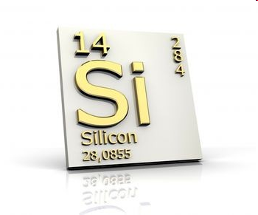
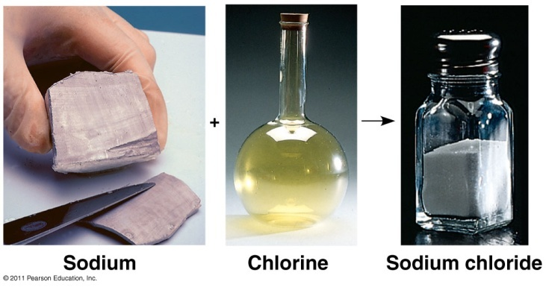
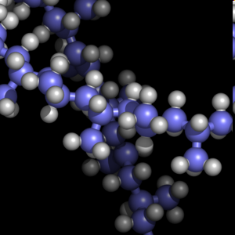
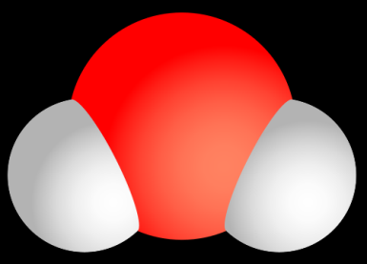
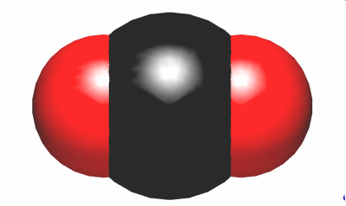
Element
“pure” substance
Can’t be broken down by “ordinary” means to another substance
Ex. hydrogen (H), nitrogen (N)
Compound
2 or more different elements combined in a fixed ratio
Ex. H₂O, CO₂

Slide 7
Elements of Life
25 elements
96% : O, C, H, N
~ 4% : P, S, Ca, K & trace elements (ex: Fe, I)
Hint: Remember CHNOPS

Slide 8
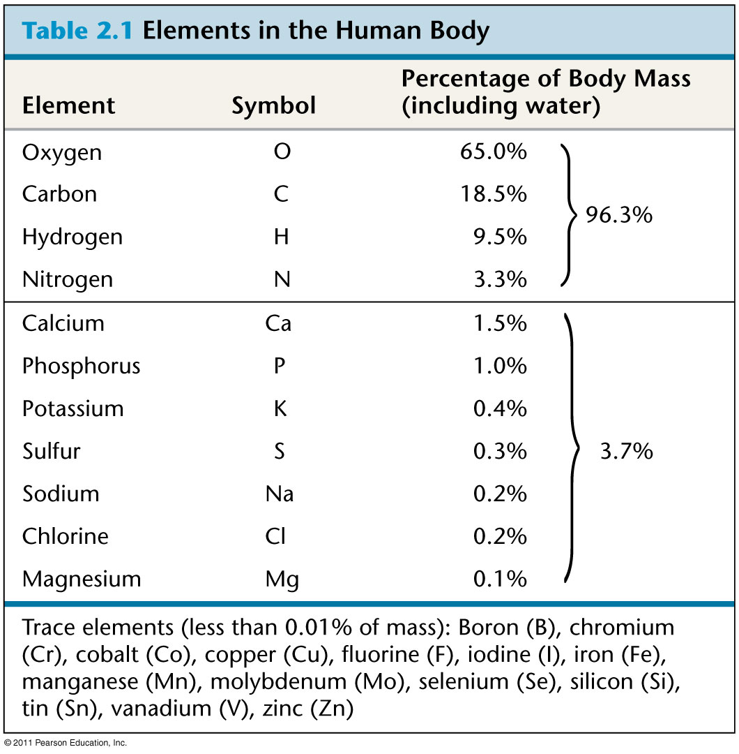

Slide 9
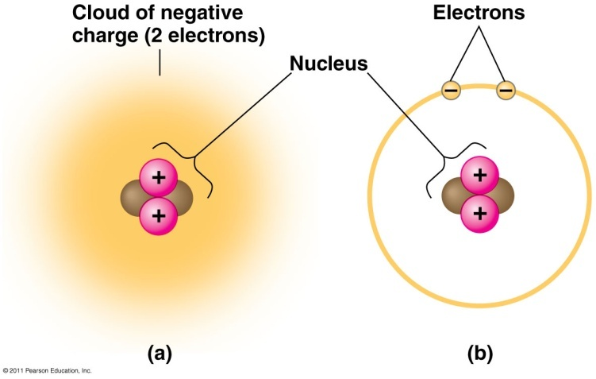
II. Atomic Structure
Atom = smallest unit of matter that retains properties of an element
Subatomic particles:
 | Mass (dalton or AMU) | Location | Charge
neutron | 1 | nucleus | 0
proton | 1 | nucleus | +1
electron | negligible | shell | -1

Slide 10
Mass # (protons + neutrons)
4
2
He
symbol
Atomic # (protons or electrons)

Slide 11
2
He
4
atomic # (never changes)
2
valence e⁻
symbol
mass #
Protons =
Electrons =
Neutrons =
2
2
2

Slide 12
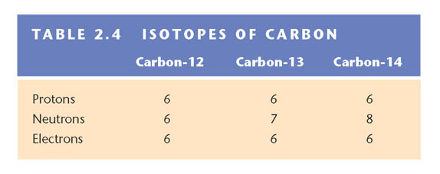
Isotopes
# neutrons varies, but same # of protons
Radioactive isotopes used as tracers (follow molecules, medical diagnosis)
Uncontrolled exposure causes harm

Slide 13
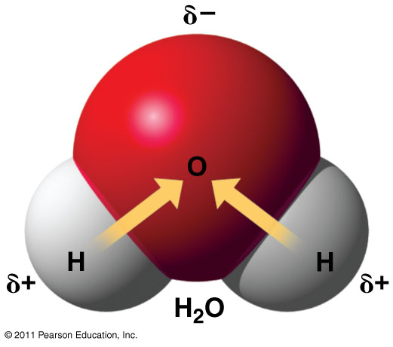
III. Chemical Bonds
Strongest Bonds:
Covalent: sharing of e⁻
Polar: covalent bond between atoms that differ in electronegativity
Nonpolar: e⁻ shared equally; eg. O₂ or H₂

Slide 14
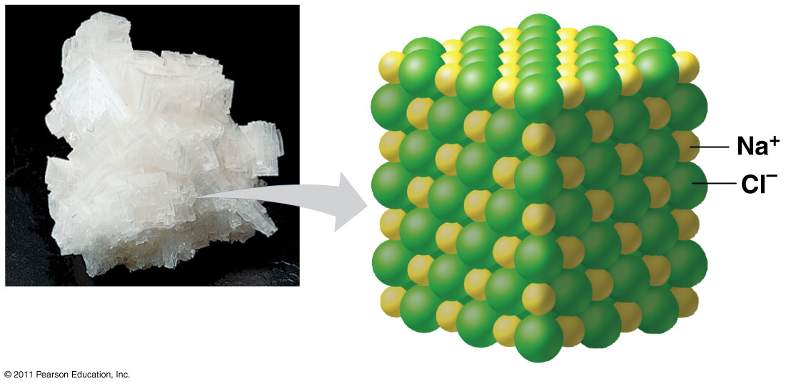
III. Chemical Bonds
Strongest Bonds:
Ionic: 2 ions (+/-) bond (givers/takers)
Na⁺Cl⁻
Affected by environment (eg. water)

Slide 15
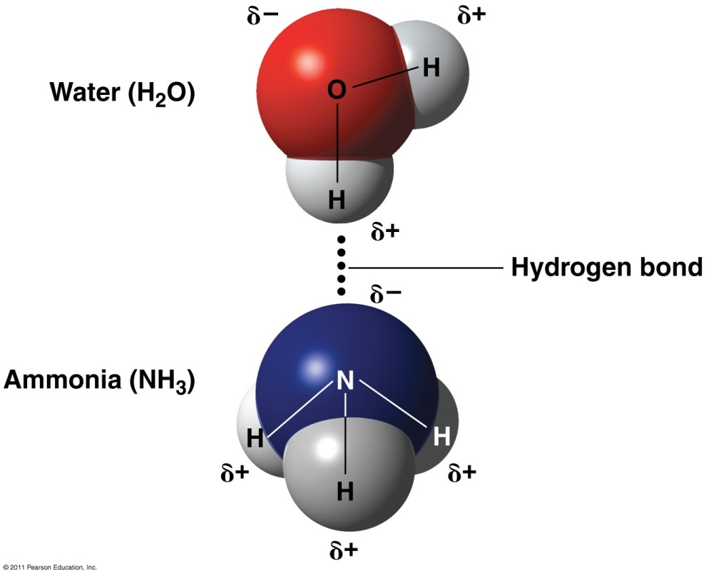
Weaker Bonds:
Hydrogen: H of polar covalent molecule bonds to electronegative atom of other polar covalent molecules

Slide 16
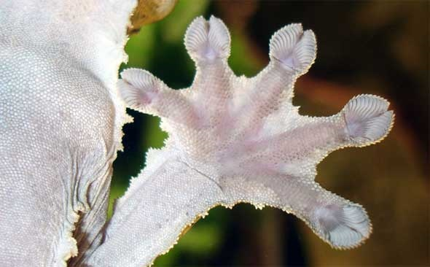
Weaker Bonds:
Van der Waals Interactions: slight, fleeting attractions between atoms and molecules close together
Weakest bond
Eg. gecko toe hairs + wall surface

Slide 17
Bonds
Covalent | Ionic | Hydrogen
All important to life
Form cell’s molecules | Quick reactions/ responses | H bonds to other electronegative atoms
Strong bond | Weaker bond (esp. in H₂O) | Even weaker
Made and broken by chemical reactions

Slide 18
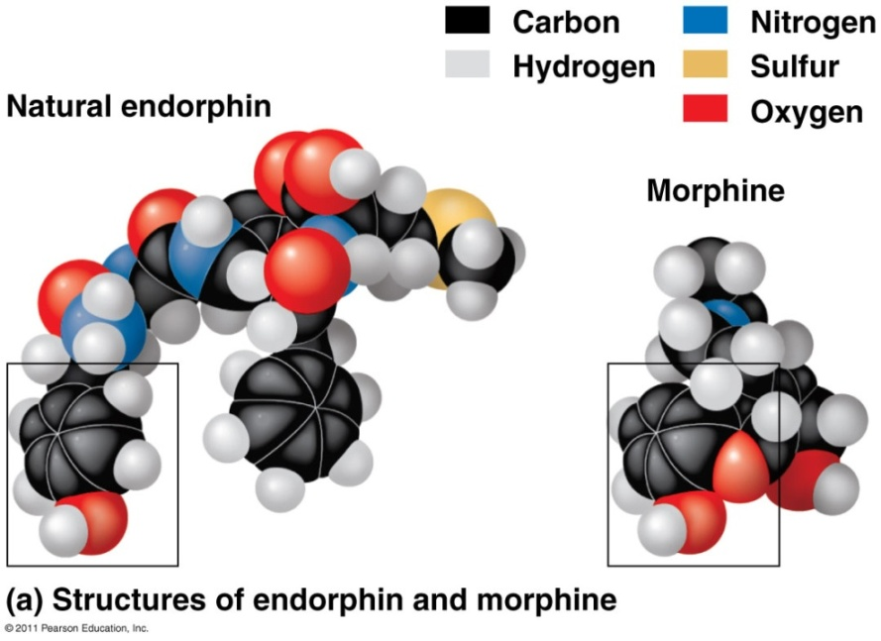
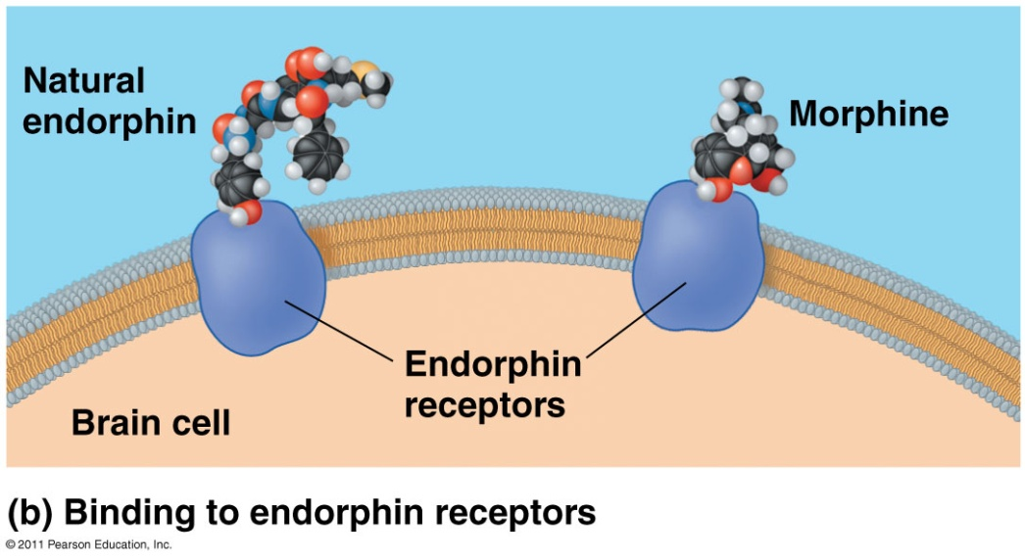
All bonds affect molecule’s SHAPE → affect molecule’s FUNCTION
Similar shapes = mimic
morphine, heroin, opiates mimic endorphin (euphoria, relieve pain)

Slide 19
Chemical Reactions
Reactants → Products
Eg. 6CO₂ + 6H₂O → C₆H₁₂O₆ + O₂
Some reactions are reversible:
Eg. 3H₂ + N₂ 2NH₃
Chemical equilibrium: point at which forward and reverse reactions offset one another exactly
Reactions still occurring, but no net change in concentrations of reactants/products

