Slide 1
ALL ABOUT PROTEINS
PART 1: Molecular Basis of Ineritance

Slide 2
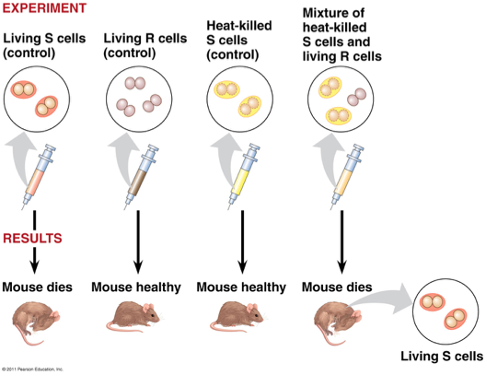
Frederick Griffith (1928)

Slide 3
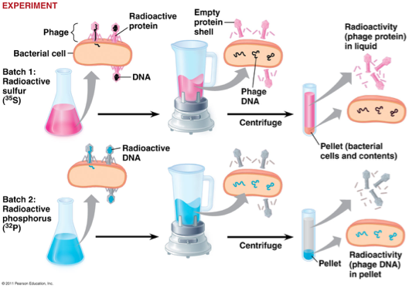
Hershey and Chase (1952)

Slide 4
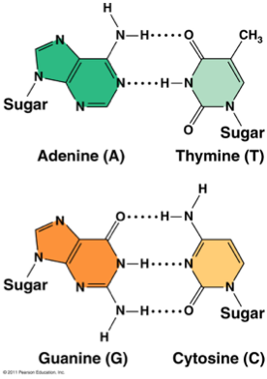
Edwin Chargaff (1947)
Chargaff’s Rules:
¨DNA composition varies
between species
¨Ratios:
¤%A = %T and %G = %C

Slide 5
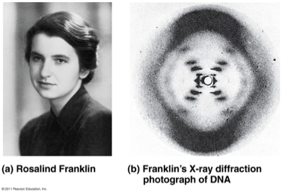
Rosalind Franklin (1950’s)
¨Worked with Maurice Wilkins
¨X-ray crystallography = images of DNA
¨Provided measurements on chemistry of DNA

Slide 6
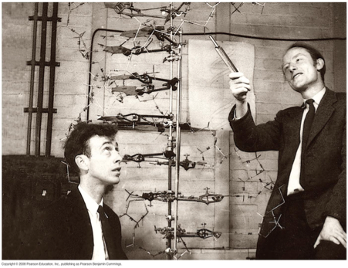
James Watson and Francis Crick (1953)
¨Discovered the double helix by building models to conform to Franklin’s X-ray data and Chargaff’s Rules.

Slide 7
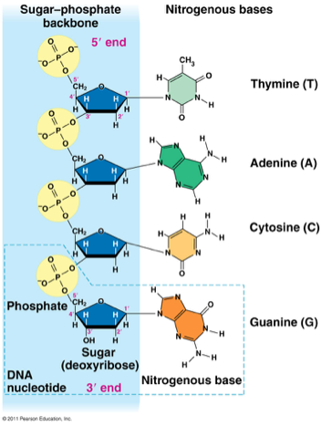
Structure of DNA
DNA = double helix
¤“Backbone” = sugar +
phosphate
¤“Rungs” = nitrogenous
bases

Slide 8
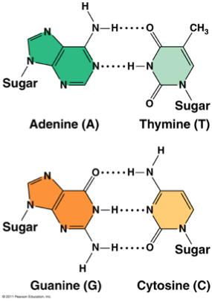
Nitrogenous Bases
¤Adenine (A)
¤Guanine (G)
¤Thymine (T)
¤Cytosine (C)
¨Pairing:
¤purine + pyrimidine
¤A = T
¤G Ξ C

Slide 9
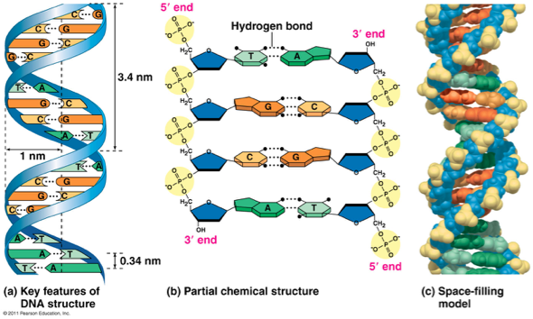
Hydrogen Bonds

Slide 10
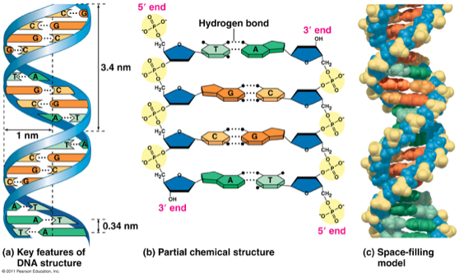
Antiparallel
One strand (5’à 3’), other strand runs in opposite, upside-down direction (3’ à 5’)

Slide 11
DNA Comparison
Prokaryotes
¨Double-stranded
¨Circular
¨One chromosome
¨In cytoplasm
¨No histones
¨Supercoiled DNA
Eukaryotes
¨Double-stranded
¨Linear
¨Usually 1+ chromosomes
¨In nucleus
¨DNA wrapped around histones
(proteins)
¨Forms chromatin

Slide 12
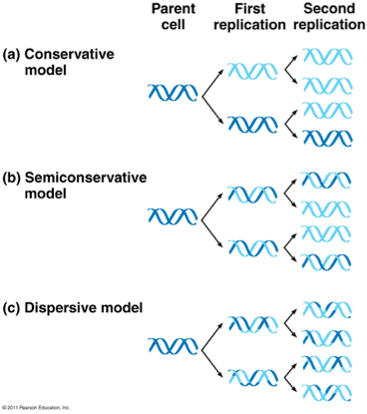
Replication

Slide 13
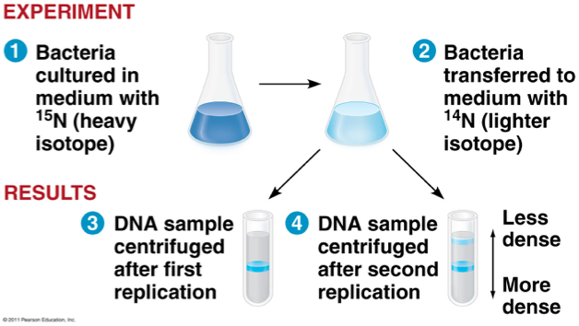
Meselson and Stahl

Slide 14
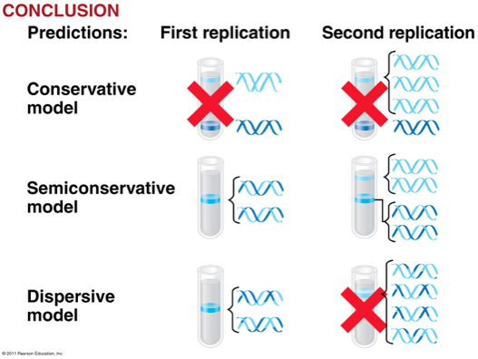

Slide 15
Major Steps of Replication
1.Helicase: unwinds DNA at origins of replication
2.Initiation proteins separate 2 strands à forms replication bubble
3.Primase: puts down RNA primer to start replication
4.DNA polymerase III: adds complimentary bases to leading strand (new DNA is made 5’ à 3’)
5.Lagging strand grows in 3’à5’ direction by the addition of Okazaki fragments
6.DNA polymerase I: replaces RNA primers with DNA
7.DNA ligase: seals fragments together

Slide 16
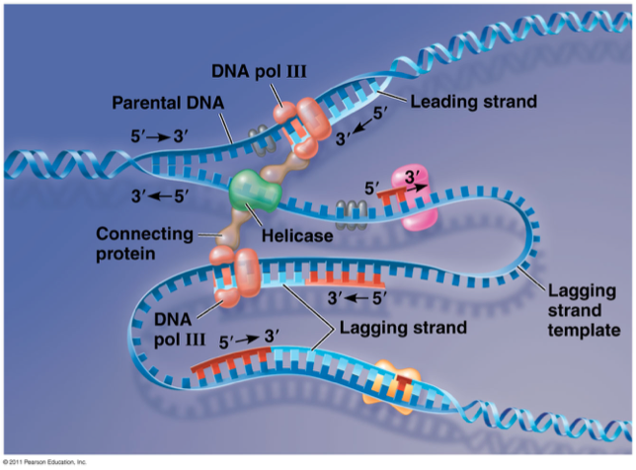

Slide 17
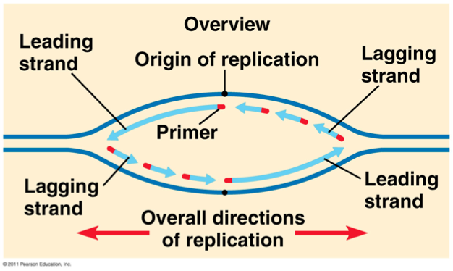
Leading vs Lagging Strand

Slide 18
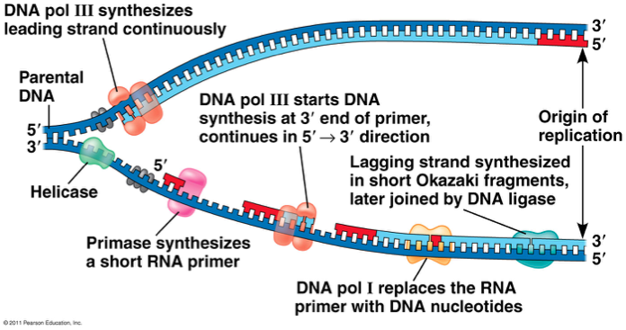

Slide 19
Proofreading and Repair
¨DNA polymerases proofread as bases added
¨Mismatch repair: special enzymes fix incorrect pairings
¨Nucleotide excision repair:
¤Nucleases cut damaged DNA
¤DNA poly and ligase fill in gaps

Slide 20
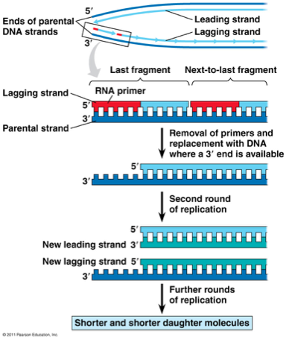
Problem at 5’ End
¨DNA poly only adds nucleotides to 3’ end
¨No way to complete 5’ ends of daughter strands
¨Over many replications, DNA strands will grow shorter and shorter

Slide 21
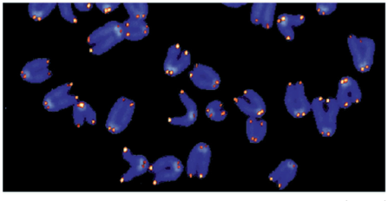
Telemeres
¨Telomeres “cap” ends of
DNA to postpone erosion
of genes at ends
(TTAGGG)
¨Telomerase: enzyme that adds to
telomeres
¤Eukaryotic germ cells, cancer cells

Slide 22
ALL ABOUT PROTEINS
PART 2: GENE TO PROTEIN

Slide 23
Gene Expression
}Old idea: one gene-one enzyme hypothesis
Proposed by Beadle & Tatum – mutant mold experiments
Function of a gene = dictate production of specific enzyme
}Newer idea: one gene-one polypeptide hypothesis
Most accurate: one gene-one RNA molecule (which can be translated into a polypeptide)

Slide 24
Flow of Genetic Information
}Central Dogma: DNA à RNA à protein
}Transcription: DNA à RNA
}Translation: RNA à protein
}Ribosome = site of translation

Slide 25
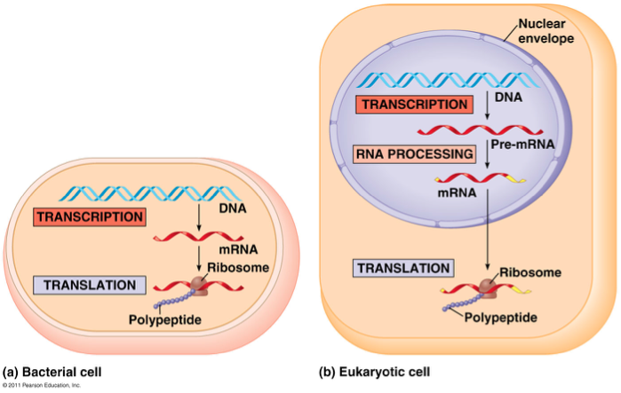

Slide 26
DNA vs RNA
DNA
}Nucleic acid composed
of nucleotides
}Double-stranded
}Deoxyribose=sugar
}Thymine
}Template for individual
RNA
}Nucleic acid composed of nucleotides
}Single-stranded
}Ribose=sugar
}Uracil
}Many different roles!

Slide 27
RNA Roles
1.pre-mRNA=precursor to mRNA, newly transcribed and not edited
2.mRNA= the edited version; carries the code from DNA that specifies amino acids
3.tRNA= carries a specific amino acid to ribosome based on its anticodon to mRNA codon
4.rRNA= makes up 60% of the ribosome; site of protein synthesis
5.snRNA=small nuclear RNA; part of a spliceosome. Has structural and catalytic roles
6.srpRNA=a signal recognition particle that binds to signal peptides
7.RNAi= interference RNA; a regulatory molecule
8.ribozyme= RNA molecule that functions as an enzyme

Slide 28
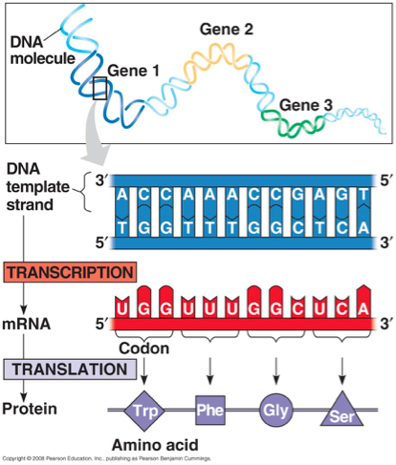
Genetic Code
For each gene, one DNA strand is the template strand
mRNA (5’ à 3’) complementary to template
mRNA triplets (codons) code for amino acids in polypeptide chain

Slide 29
Transcription
Transcription unit: stretch of DNA that codes for a polypeptide or RNA (eg. tRNA, rRNA)
RNA polymerase:
}Separates DNA strands and transcribes mRNA
}mRNA elongates in 5’ à 3’ direction
}Uracil (U) replaces thymine (T) when pairing to adenine (A)
}Attaches to promoter (start of gene) and stops at terminator (end of gene)

Slide 30
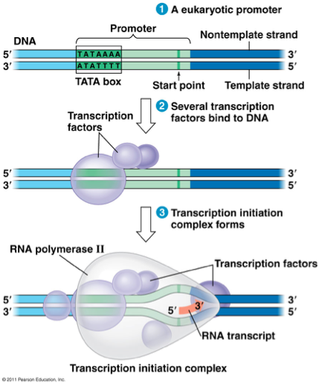
Transcription
Initiation in Eukaryotes:
TATA box = DNA sequence (TATAAAA) upstream from promoter
Transcription factors must recognize TATA box before RNA polymerase can bind to DNA promoter

Slide 31
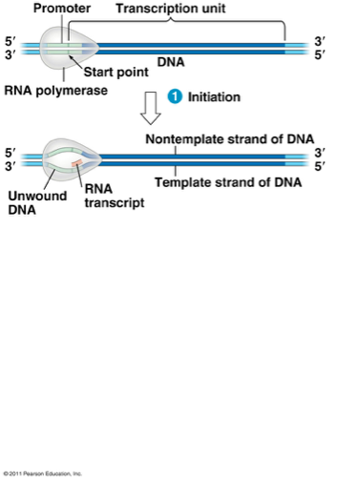
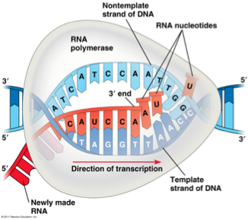
Transcription
Elongation
•RNA polymerase adds RNA nucleotides to the 3’ end of the growing chain (A-U, G-C)

Slide 32
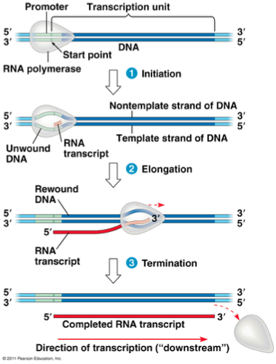
Termination
RNA polymerase transcribes a terminator sequence in DNA, then mRNA and polymerase detach.
It is now called pre-mRNA for eukaryotes.
Prokaryotes = mRNA ready for use

Slide 33
RNA Modificatoion
}5’ cap (modified guanine) and 3’ poly-A tail (50-520 A’s) are added
}Help export from nucleus, protect from enzyme degradation, attach to ribosomes

Slide 34
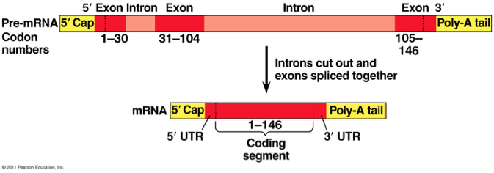
RNA Splicing
}Pre-mRNA has introns (noncoding sequences) and exons (codes for amino acids)
}Splicing = introns cut out, exons joined together

Slide 35
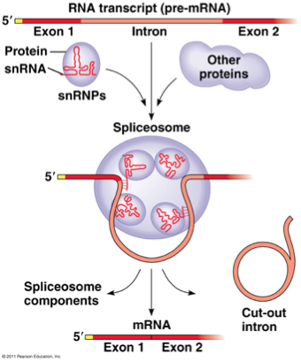
RNA Splicing
}small nuclear ribonucleoproteins = snRNPs
}snRNP = snRNA + protein
}Pronounced “snurps”
}Recognize splice sites
}snRNPs join with other proteins to form a spliceosome
Spliceosomes catalyze the process of removing introns and joining exons
Ribozyme = RNA acts as enzyme

Slide 36
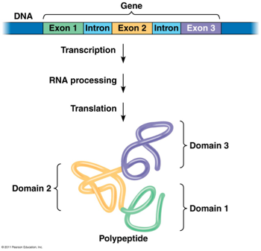
Why Have Introns
}Some regulate gene activity
}Alternative RNA Splicing: produce different combinations of exons
}One gene can make more than one polypeptide!
}20,000 genes à 100,000 polypeptides

Slide 37
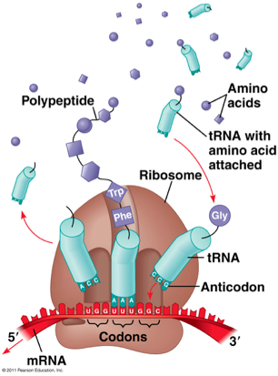
Components of Translation
1.mRNA = message
2.tRNA = interpreter
3.Ribosome = site of
translation

Slide 38
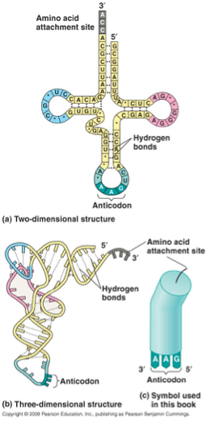
tRNA
}Transcribed in nucleus
}Specific to each amino acid
}Transfer AA to ribosomes
}Anticodon: pairs with complementary mRNA codon
}Base-pairing rules between 3rd base of codon & anticodon are not as strict. This is called wobble.

Slide 39
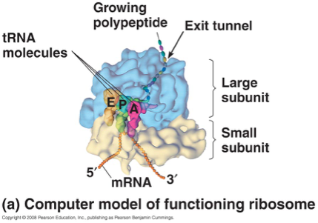
Ribosome

Slide 40
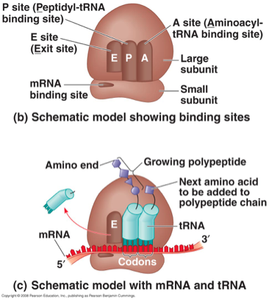

Slide 41
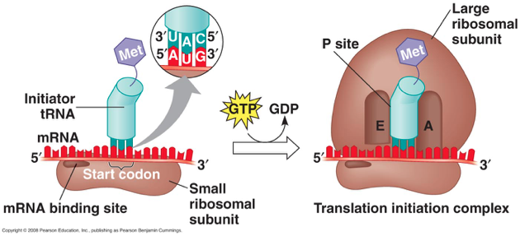
Initiation

Slide 42
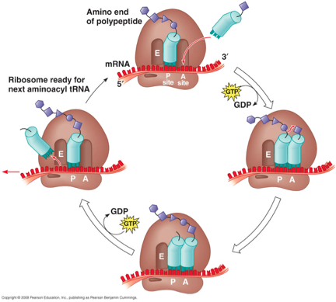
Elongation

Slide 43
Termination
}Stop codon reached and translation stops
}Release factor binds to stop codon; polypeptide is released
}Ribosomal subunits dissociate

Slide 44
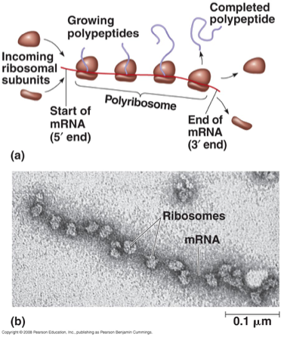
Polyribosomes

Slide 45
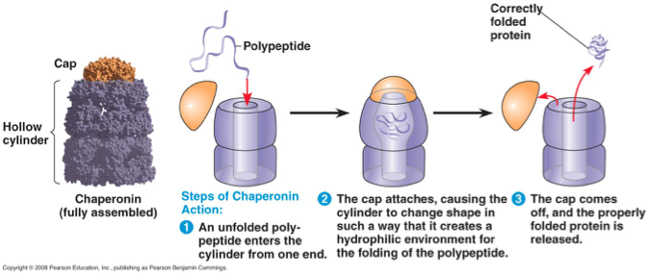
Protein Folding

Slide 46
Mutations
}Large scale mutations: chromosomal; always cause disorders or death - nondisjunction, translocation, inversions, duplications, large deletions
} Point mutations: alter 1 base pair of a gene
1.Base-pair substitutions – replace 1 with another
}Missense: different amino acid
}Nonsense: stop codon, not amino acid
2.Frameshift – mRNA read incorrectly; nonfunctional
proteins
}Caused by insertions or deletions

Slide 47
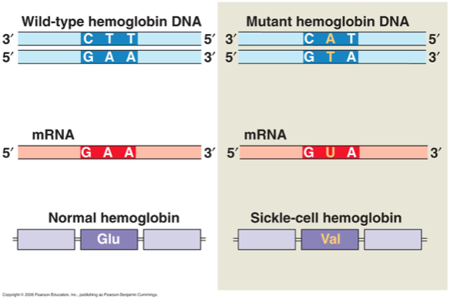
Sickle Cell Disease

Slide 48
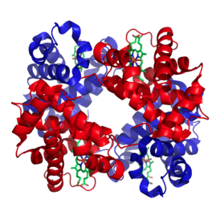
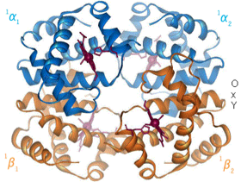
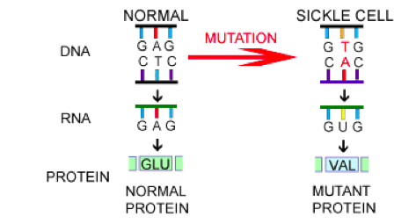

Slide 49
Prokaryotes vs Eukaryotes
Prokaryotes
}Transcription and translation both in cytoplasm
}DNA/RNA in cytoplasm
}RNA poly binds directly to promoter
}Transcription makes mRNA (not processed)
}No introns
Eukaryotes
}Transcription in nucleus; translation in cytoplasm
}DNA in nucleus, RNA travels in/out nucleus
}RNA poly binds to TATA box & transcription factors
}Transcription makes pre-mRNA à RNA processing à final mRNA
}Exons, introns (cut out)

Slide 50
ALL ABOUT PROTEINS
PART 3: GENE REGULATION

Slide 51
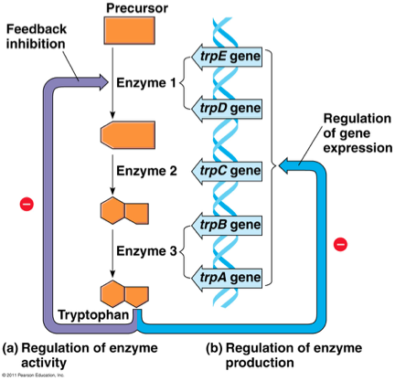
Regulation of Metabolic Pathways

Slide 52
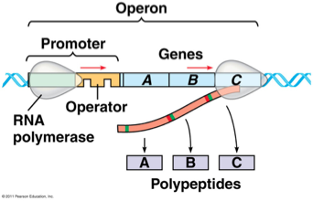
Bacterial Control: Operons
Three Parts:
1.Promoter – where RNA polymerase attaches
2.Operator – “on/off”, controls access of RNA poly
3.Genes – code for related enzymes in a pathway

Slide 53
Repressible Operon
}Normally ON
}Anabolic (build organic molecules)
}Organic molecule product acts as corepressor à binds to repressor to activate it
}Operon is turned OFF
}Eg. trp operon

Slide 54
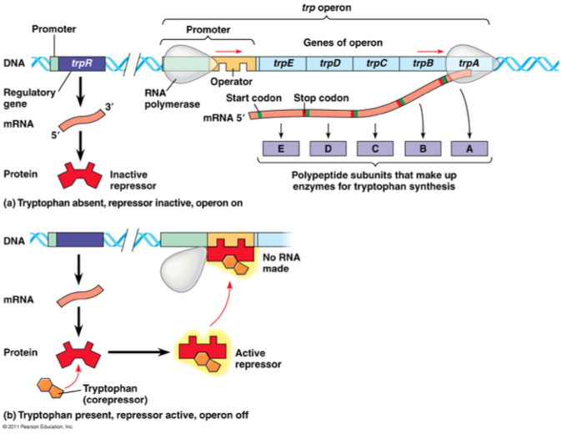

Slide 55
Inducible Operon
}Normally OFF
}Catabolic (break down food for energy)
}Repressor is active à inducer binds to and inactivates repressor
}Operon is turned ON
}Eg. lac operon

Slide 56
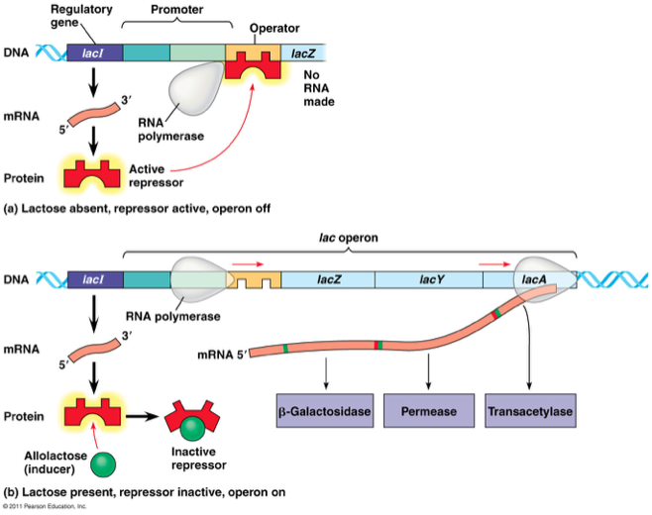

Slide 57
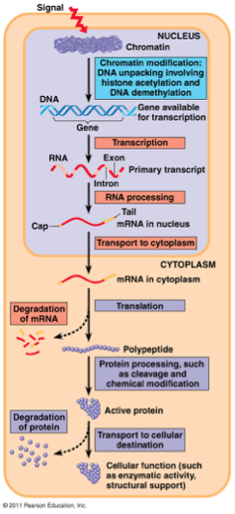
Eukaryotic expression can be regulated at a variety of steps

Slide 58
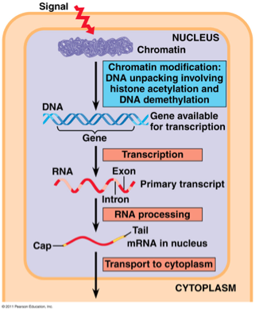
Chromatin Regulation
Chromatin Structure:
}Tightly bound DNA less accessible for transcription
}DNA methylation: methyl groups added to DNA; tightly packed; ¯ transcription
}Histone acetylation: acetyl groups added to histones; loosened; ­ transcription

Slide 59
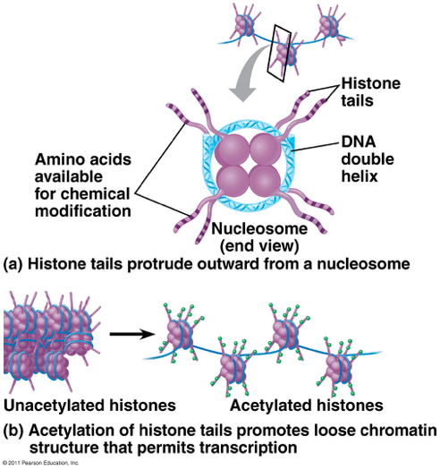

Slide 60
Epigenetic Inheritance
}Modifications on chromatin can be passed on to future generations
}Unlike DNA mutations, these changes to chromatin can be reversed (de-methylation of DNA)
}Explains differences between identical twins

Slide 61
Transcription Initiation
Transcription Initiation:
}Control elements bind transcription factors
}Enhances gene expression

Slide 62
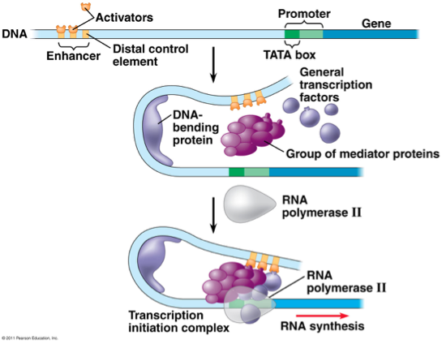
Transcription Initiation Complex
Enhancer regions bound to promoter region by activators

Slide 63
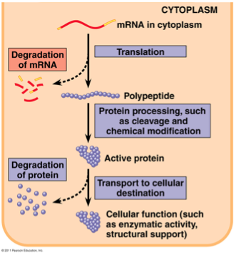
Regulation of mRNA
Regulation of mRNA:
•micro RNAs (miRNAs) and small interfering RNAs (siRNAs) can bind to mRNA and degrade it or block translation

Slide 64
