Slide 1
BIOCHEMISTRY
AP BIOLOGY 2015-16

Slide 2
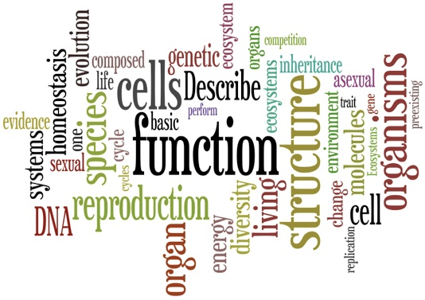
MOST IMPORTANT ELEMENTS
CHNOPS
What are they?
What are they used for?
How do we get them?

Slide 3
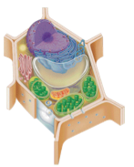
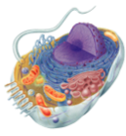
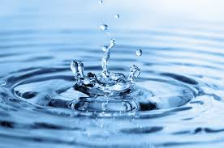
WHY STUDY CARBON?
All life is built on carbon
Cells
≅72% Water
25% carbon compounds
carbohydrates
lipids
proteins
nucleic acids
3% salt (Na, K, Cl)

Slide 4
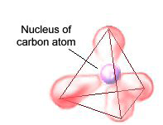
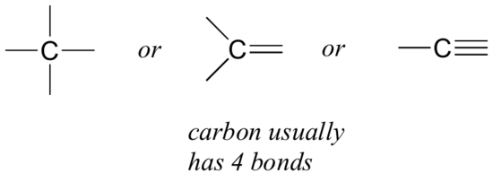
CARBON IS A UNIQUE COMPOUND
Versatile
atomic number = 6
tetravalence
4 stable covalent bonds

Slide 5
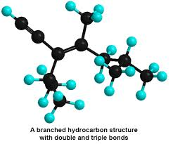
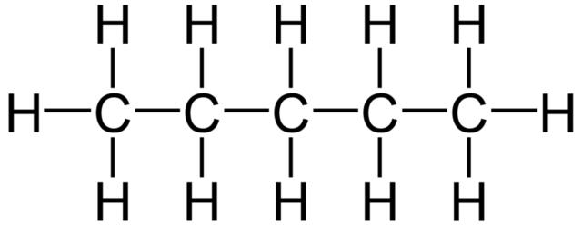
HYDROCARBONS
combination of C and H
non-polar
hydrophobic
stable

Slide 6
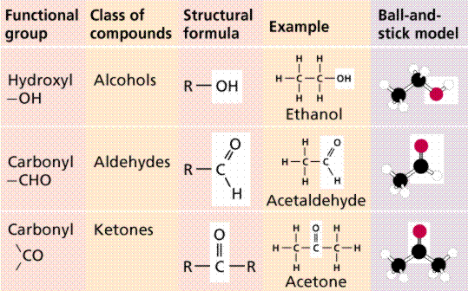
FUNCTIONAL GROUPS

Slide 7
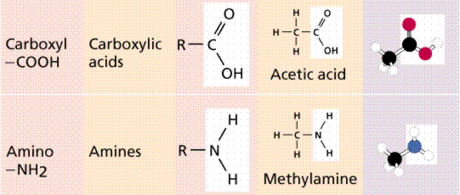
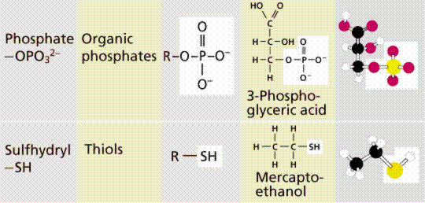

Slide 8
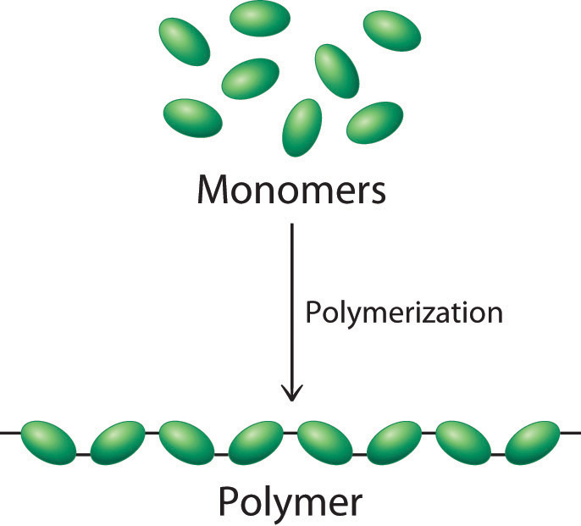
POLYMERS
long molecules built by repeating units in a chain
monomer = building block
covalent bonds

Slide 9
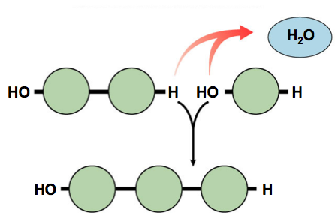
BUILDING POLYMERS
Dehydration Synthesis (Condensation reaction)
requires energy and enzymes
builds a polymer by removing an H₂O molecule.
one monomer donates an -OH⁻
the other monomer donates an H⁺

Slide 10
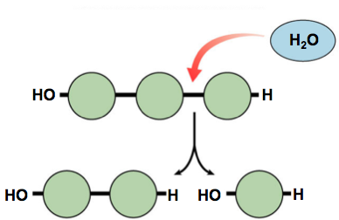
DIGESTING POLYMERS
Digestion (Hydrolysis)
opposite of synthesis
uses H₂O to cleave off one monomer at a time
requires enzymes
releases energy

Slide 11
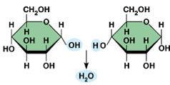
CARBOHYDRATES
Elements: C, H, O
Monomer: monosaccharide
Function:
energy
raw materials
energy storage
structural components
glycosidic bond

Slide 12
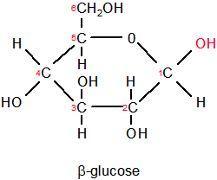
Sugars
most end in -ose
classified by number of carbons
3C = triose (glyceraldehyde)
5C = pentose (ribose)
6C = hexose (glucose)

Slide 13
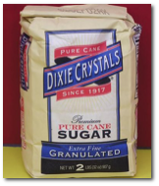
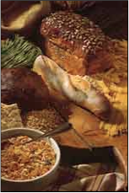
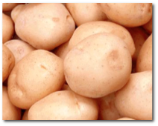
Simple and Complex Sugars
Monosaccharides
simple, one monomer sugars (glucose)
Disaccharides
two monomers (sucrose, maltose, lactose)
Polysaccharides
three or more monomers (starch)

Slide 14
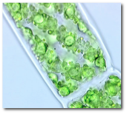
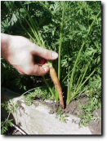
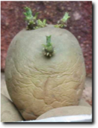
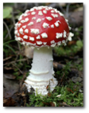
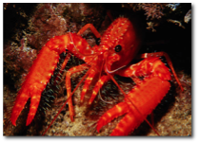
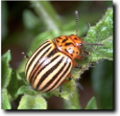
Polysaccharides
Function
energy storage
glycogen
starch
structural
cellulose
chitin

Slide 15
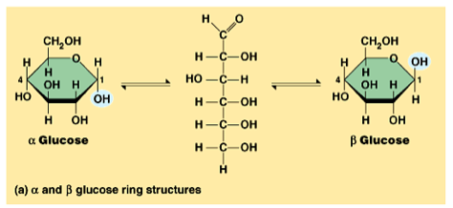
POLYSACCHARIDE DIVERSITY
isomers of glucose
“structure determines function”
STARCH
CELLULOSE

Slide 16
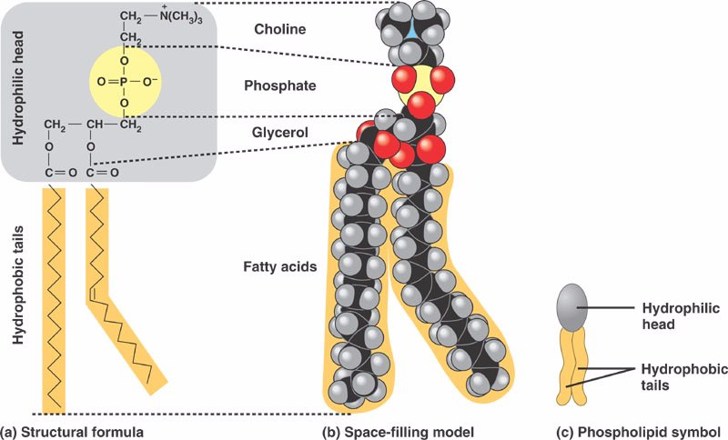
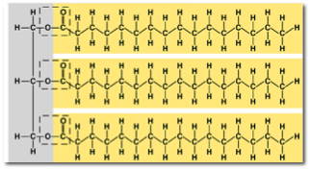
LIPIDS
Elements: C, H, O
Monomer: none (not a polymer)
Function:
energy storage
insulation
shock absorption
Groups:
fats
steroids
phospholipids

Slide 17
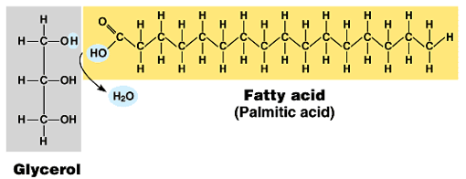
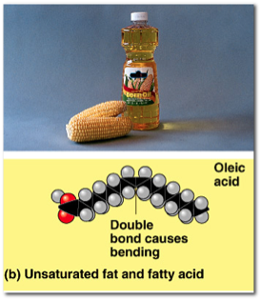
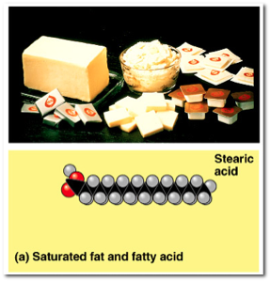
FATS
Structure
glycerol and 3 fatty acids
Types
saturated
unsaturated

Slide 18
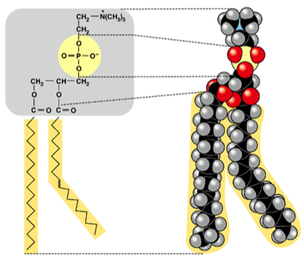
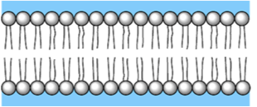
PHOSPHOLIPIDS
Structure
1 glycerol, 2 fatty acids, 1 PO4
amphipathic
form a bilayer membrane

Slide 19
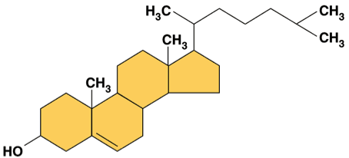
STEROIDS
Structure
4 fused rings + ??
different steroids created by the molecule(s) that attach to the rings
Examples
cholesterol
sex hormones

Slide 20
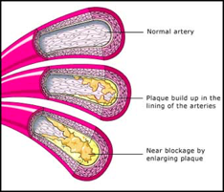
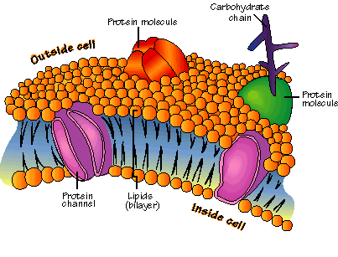
CHOLESTEROL
important cell component
precursor for all steroids
high levels contribute to cardiovascular disease

Slide 21
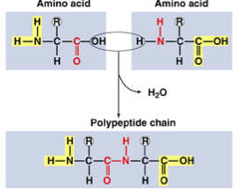
PROTEINS
Elements: C, H, O, N, S
Monomer: amino acids (20 different)
Function:
enzymes
structure
transport
defense
cell communication
movement
storage

Slide 22
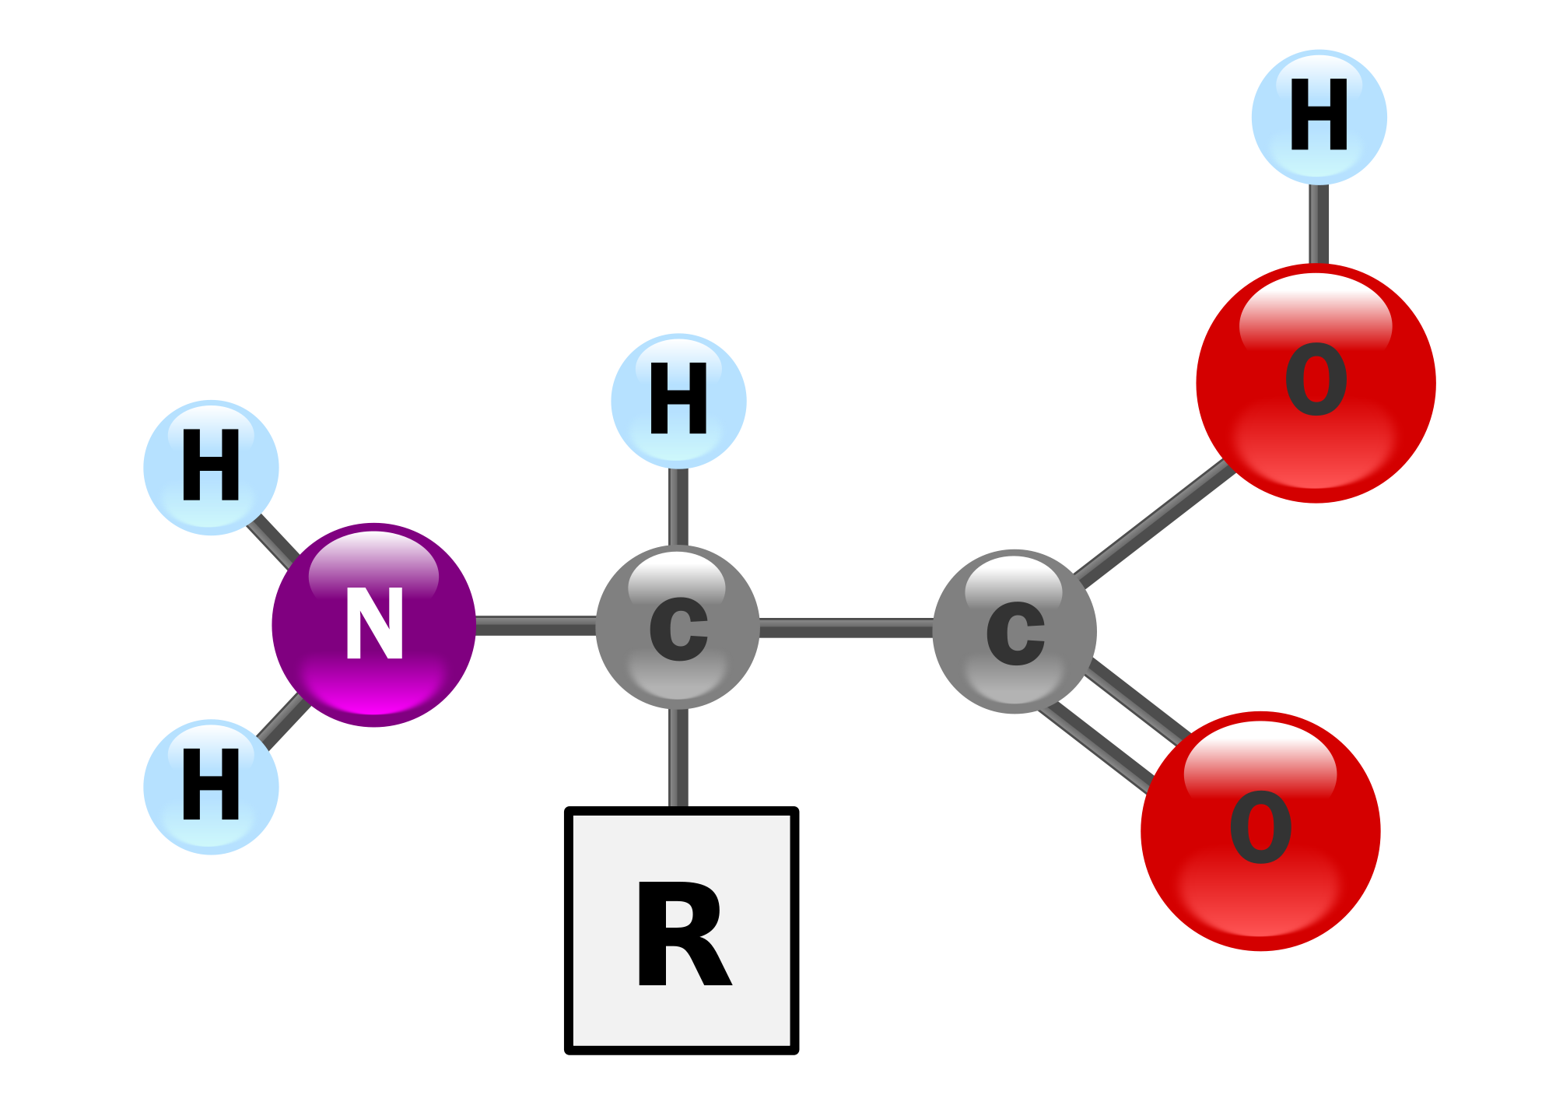
AMINO ACIDS
R-group
variable for each
20 different
properties vary

Slide 23
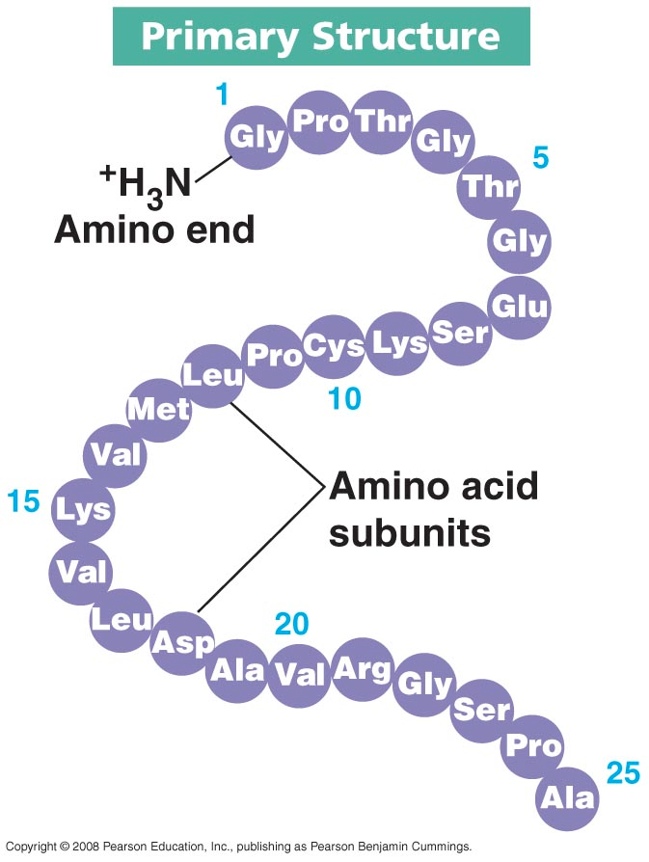
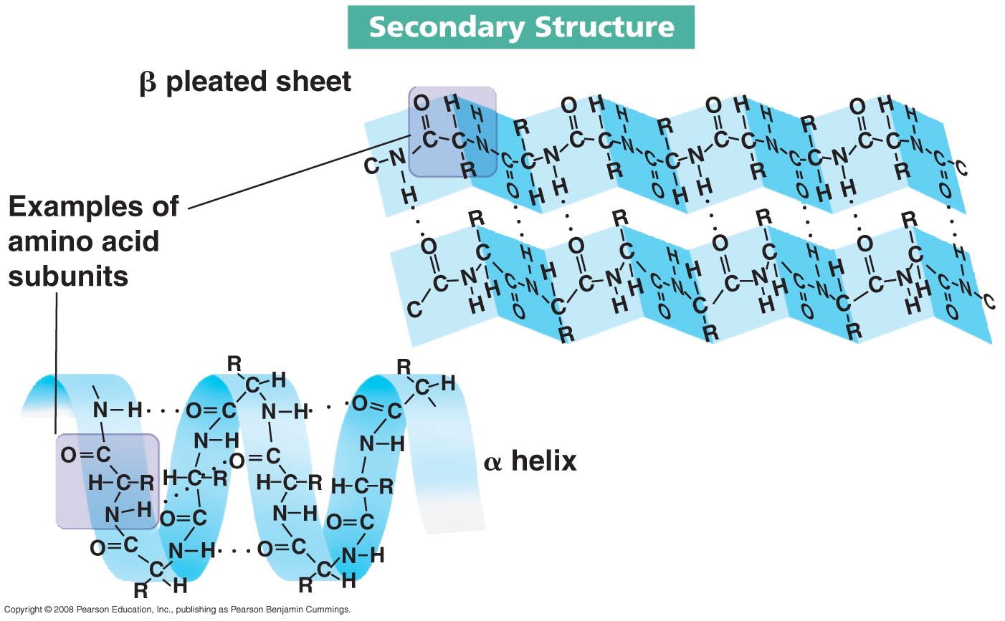
PROTEIN FOLDING

Slide 24
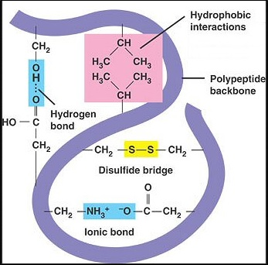
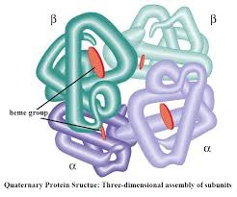
PROTEIN FOLDING
Tertiary Structure
Quaternary Structure

Slide 25
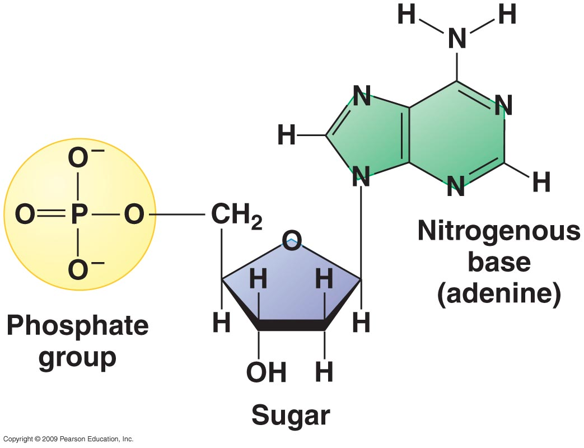
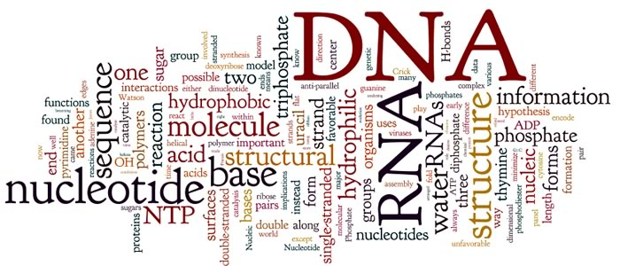
NUCLEIC ACIDS
Elements: C, H, O, N, P
Monomer: nucleotides
Function: genetic material

Slide 26
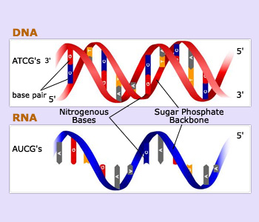
NUCLEIC ACIDS
Examples:
DNA (Deoxyribonucleic acid)
RNA (Ribonucleic acid)

Slide 27
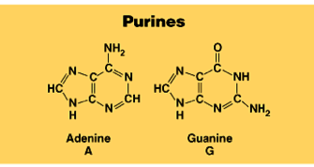
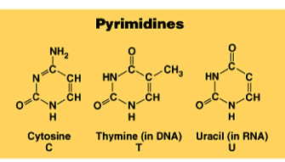
TYPES OF NUCLEOTIDES
Purines (double ring)
guanine and adenine
Pyrimidines (single ring)
cytosine, thymine, and uracil
Base-pairing
A :: T
C ::: G

Slide 28
INTRODUCTION TO METABOLISM

Slide 29
CHEMICAL REACTIONS AND ENERGY
2 types of reactions
Exergonic (release energy)
catabolism
hydrolysis (digesting polymers)
spontaneous
- G
Endergonic (input of energy)
anabolism
synthesis
nonspontaneous
+ G

Slide 30
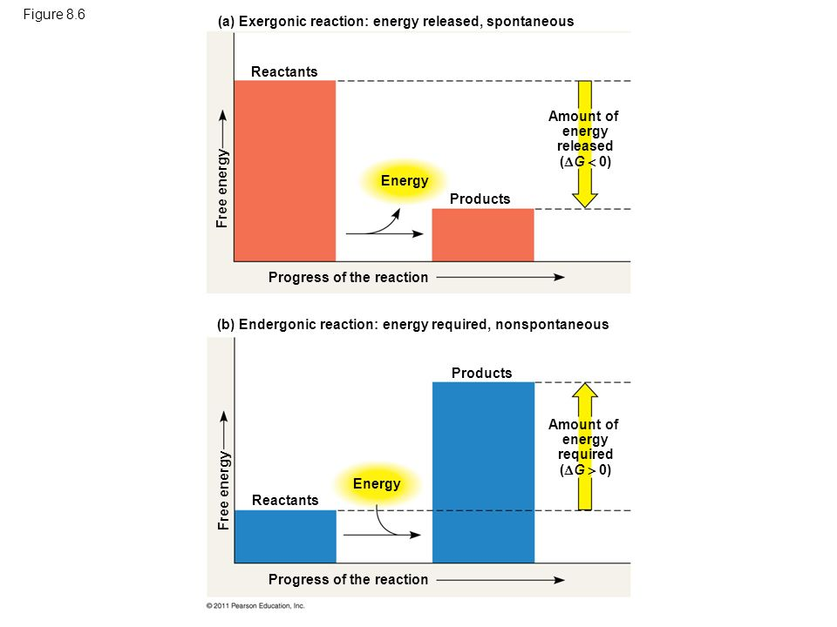

Slide 31
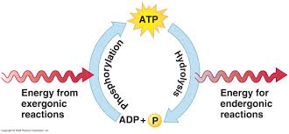
COUPLED REACTIONS

Slide 32
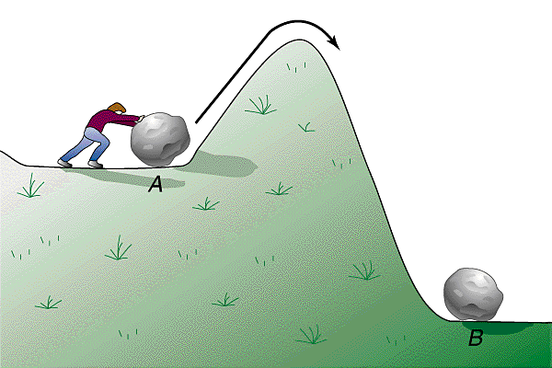
ACTIVATION ENERGY
initial input of energy required for a reaction to occur
moves the reaction over an “energy hill”

Slide 33
CATALYST
Reduces activation energy to start a reaction

Slide 34
ENZYMES
proteins and RNA
facilitate chemical reactions
increase rate of reaction without being consumed
reduce activation energy
don’t change free energy released or required
highly specific

Slide 35
ENZYMES
substrate
product
active site

Slide 36
PROPERTIES OF ENZYMES
reaction specific
each enzyme has a specific substrate
not consumed in reaction
single enzyme can act on thousands of substrate molecules
affected by cellular conditions
temperature, pH, salinity

Slide 37
LOCK AND KEY MODEL
Simplistic model of enzyme action
substrate fits into 3-D structure of enzyme’ active site
H bonds between substrate & enzyme
like “key fits into lock”

Slide 38
INDUCED FIT MODEL
More accurate model of
enzyme action
3-D structure of enzyme fits substrate
substrate binding cause enzyme to change shape leading to a tighter fit
“conformational change”
bring chemical groups in position to catalyze reaction

Slide 39
FACTORS AFFECTING FUNCTION
enzyme concentration
substrate concentration
temperature
pH
salinity
activators
inhibitors

Slide 40
COMPOUNDS WHICH HELP ENZYMES
Activators
cofactors
inorganic
bound within enzymes
ex: Fe, K, Cu, Ca
coenzymes
organic
bound near active site
ex: vitamins

Slide 41
COMPOUNDS WHICH REGULATE ENZYMES
Inhibitors
competitive inhibition
noncompetitive inhibition
feedback inhibition

Slide 42
COMPETITIVE INHIBITOR
Inhibitor & substrate “compete” for active site
penicillin - blocks enzyme bacteria use to build cell walls
disulfiram (Antabuse) - treats chronic alcoholism
blocks enzyme that breaks down alcohol
severe hangover & vomiting
5-10 minutes after drinking
overcome by increasing substrate concentration
saturate solution with substrate so it out-competes inhibitor for active site on enzyme

Slide 43
NONCOMPETITIVE INHIBITOR
Inhibitor binds to site other than active site
allosteric inhibitor binds to allosteric site
causes enzyme to change shape
conformational change
active site is no longer functional binding site
some anti-cancer drugs
inhibit enzymes involved in DNA synthesis
stop DNA production and division of more cancer cells
cyanide poisoning
irreversible inhibitor of Cytochrome C, an enzyme in cellular respiration
stops production of ATP

Slide 44
ALLOSTERIC REGULATION
Conformational changes by regulatory molecules
inhibitors
keeps enzyme in
inactive form
activators
keeps enzyme in
active form

Slide 45
FEEDBACK INHIBITION
Regulation & coordination of production
product is used by next step in pathway
final product is inhibitor of earlier step
allosteric inhibitor of earlier enzyme
no unnecessary accumulation of product

