Slide 1

Section 3: Writing Formulas and Naming Compounds
For both ionic and covalent compounds, you can write a name from the chemical formula or a chemical formula from the name.
K What I Know | W What I Want to Find Out | L What I Learned

Slide 2

6(D) Relate the physical and chemical behavior of an element, including bonding and classification, to its placement on the Periodic Table.
2(E) Communicate valid conclusions.
Writing Formulas and Naming Compounds
Copyright © McGraw-Hill Education

Slide 3
Essential Questions
How are oxidation numbers determined?
How are formulas for ionic and covalent compounds written?
How are ionic and covalent compounds named?
Writing Formulas and Naming Compounds
Copyright © McGraw-Hill Education

Slide 4
Vocabulary
Review
ion
New
oxidation number
binary compound
polyatomic ion
hydrate
Writing Formulas and Naming Compounds
Copyright © McGraw-Hill Education

Slide 5
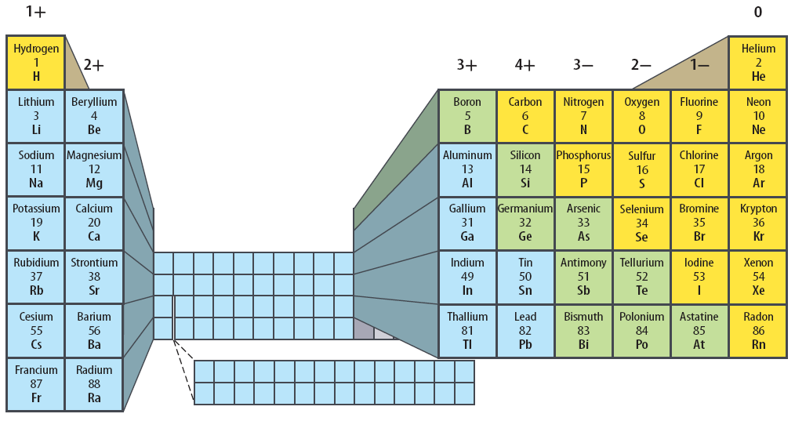
Oxidation numbers
The number at the top of each column is the most common oxidation number of elements in that group.
Writing Formulas and Naming Compounds
Copyright © McGraw-Hill Education

Slide 6
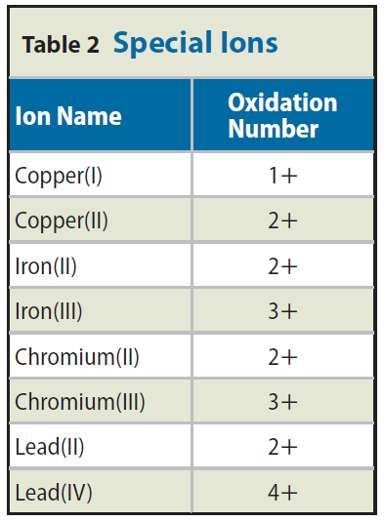
Oxidation numbers and the periodic table
The elements in this table can have more than one oxidation number.
When naming these compounds, the oxidation number is expressed in the name with a roman numeral. For example, the oxidation number of iron in iron (III) oxide is 3+.
Writing Formulas and Naming Compounds
Copyright © McGraw-Hill Education

Slide 7
Binary ionic compounds
A binary compound is one that is composed of two elements.
The first formulas of compounds you will write are for binary ionic compounds.
You need to know which elements are involved and what number of electrons they lose, gain, or share in order to become stable.
Writing Formulas and Naming Compounds
Copyright © McGraw-Hill Education

Slide 8
Binary ionic compounds
The relationship between an element’s position on the periodic table and the number of electrons it gains or loses is called the oxidation number of an element.
An oxidation number tells you how many electrons an atom has gained, or shared, to become stable.
For ionic compounds, the oxidation number is the same as the charge on the ion.
For example, a sodium ion has a charge of 1+ and an oxidation number of 1+.
Writing Formulas and Naming Compounds
Copyright © McGraw-Hill Education

Slide 9
Writing formulas
When writing formulas, it is important to remember that although the individual ions in a compound carry charges, the compound itself is neutral.
A formula must have the right number of positive ions and the right number of negative ions so the charges balance.
Writing Formulas and Naming Compounds
Copyright © McGraw-Hill Education

Slide 10
Writing Formulas
You can write formulas for ionic compounds by using the following rules in this order.
Write the symbol of the element or polyatomic ion (ions containing more than one atom) that has the positive oxidation number or charge.
Write the symbol of the element or polyatomic ion with the negative oxidation number.
The charge (without the sign) of one ion becomes the subscript of the other ion. Reduce the subscripts to the smallest whole numbers that retain the ratio of ions.
Writing Formulas and Naming Compounds
Copyright © McGraw-Hill Education

Slide 11
DETERMINE A CHEMICAL FORMULA
SOLVE FOR THE UNKNOWN
Set Up the Problem
Write the symbol of the element with the positive charge, followed by the symbol of the element with the negative charge:
Li¹⁺N^{3–}
Solve the Problem
The charge (without the sign) of one ion becomes the subscript of the other:
Li₃N₁ or Li₃N
In this case, the subscripts already reflect the smallest whole numbers that retain the ratios of the ions.
Use with Example Problem 1.
Problem
What is the formula for lithium nitride?
Response
ANALYZE THE PROBLEM
KNOWN
symbol and oxidation number of the positive ion: lithium Li¹⁺
symbol and oxidation number of the negative ion: nitrogen N^{3–}
UNKNOWN
formula for lithium nitride
EVALUATE THE ANSWER
Check the answer by determining whether your compound is neutral. The charge on three lithium ions is 3+, and the charge on one nitrogen is 3–. The compound is neutral, so the formula is correct.
Writing Formulas and Naming Compounds
Copyright © McGraw-Hill Education

Slide 12
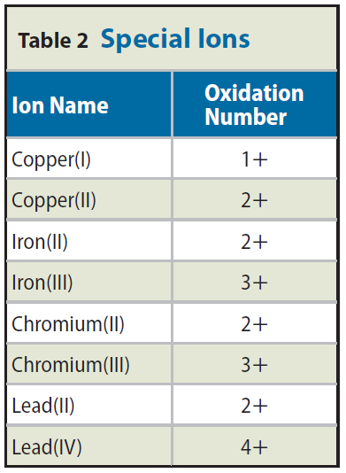
Naming
You can name a binary ionic compound from its formula by using these rules.
1. Write the name of the positive ion.
Check to see if the positive ion is capable of forming more than one oxidation number. If it is, determine the oxidation number of the ion from the formula of the compound. Then write the charge of the positive ion using roman numerals in parentheses after the ion’s name. If the ion has only one possible oxidation number, proceed to step 3.
Write the root name of the negative ion. The root is the first part of the element’s name.
Add the ending -ide to the root. The table lists several elements and their -ide counterparts.
Writing Formulas and Naming Compounds
Copyright © McGraw-Hill Education

Slide 13
NAME A BINARY IONIC COMPOUND
Use with Example Problem 2.
Problem
What would a chemist name the compound CuCl?
SOLVE FOR THE UNKNOWN
Set Up the Problem
1. Name the positive ion in the compound.
2. Check Table 2 to determine whether the positive ion can have more than one oxidation number. If it can, determine which one to use, name the positive ion, and write the charge using roman numerals in parentheses.
3. Write the root name of the negative ion.
4. Add the ending –ide to the root of the negative ion.
Solve the Problem
1. The positive ion is copper.
Response
ANALYZE THE PROBLEM
KNOWN
the names of the atoms in the compound: copper and chlorine
UNKNOWN
compound name for CuCl
Writing Formulas and Naming Compounds
Copyright © McGraw-Hill Education

Slide 14
NAME A BINARY IONIC COMPOUND
SOLVE FOR THE UNKNOWN
2. Copper has two oxidation numbers. The oxidation number for chlorine is 1-, so copper has to be 1+. The positive ion is copper(I).
3. The negative atom is chlorine. The root is chlor–.
4. Adding –ide to the negative root name is chloride.
The compound name is copper(I) chloride.
EVALUATE THE ANSWER
In an ionic compound, the positive ion is a metal and the negative ion is a nonmetal—the name should be in this order. The name copper(I) chloride has the metal first and the nonmetal second.
Copyright © McGraw-Hill Education
Writing Formulas and Naming Compounds

Slide 15
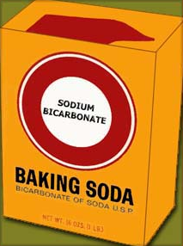
Compounds with Complex Ions
Not all ionic compounds are binary.
Baking soda has the formula NaHCO₃.
This is an example of an ionic compound that is not binary.
Some ionic compounds, including baking soda, are composed of more than two elements. They contain polyatomic ions.
A polyatomic ion is a positively or negatively charged, covalently bonded group of atoms.
Copyright © McGraw-Hill Education
Writing Formulas and Naming Compounds

Slide 16
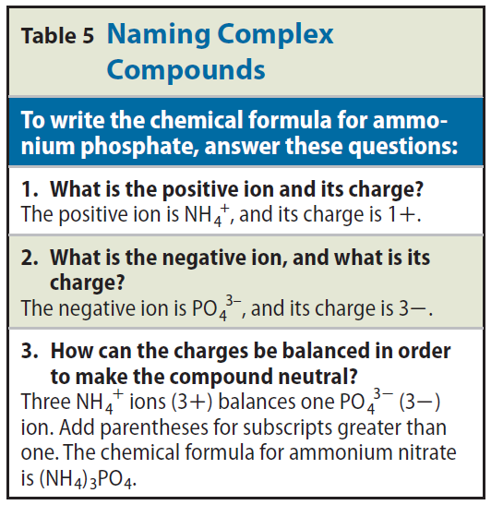
Writing Formulas
To write formulas for these compounds, follow the rules for binary compounds, with one addition.
When more than one polyatomic ion is needed, write parentheses around the polyatomic ion before adding the subscript.
Here is one example of naming a complex compound.
Writing Formulas and Naming Compounds
Copyright © McGraw-Hill Education

Slide 17
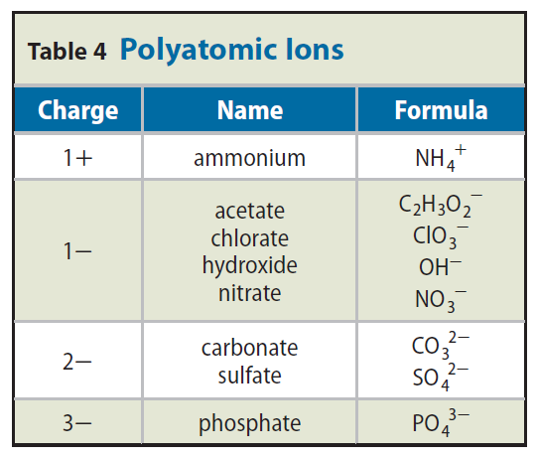
Naming
To name a compound that contains one polyatomic ion, first write the name of the positive ion.
Then write the name of the negative ion.
Copyright © McGraw-Hill Education
Writing Formulas and Naming Compounds

Slide 18
Naming Binary Covalent Compounds
Covalent compounds are those formed between elements that are nonmetals.
Some pairs of nonmetals can form more than one compound with each other.
In the system you have learned so far, N₂O, NO, NO₂, and N₂O₅ would be called nitrogen oxide. You would not know from that name what the composition of the compound is.
Writing Formulas and Naming Compounds
Copyright © McGraw-Hill Education

Slide 19
Using prefixes
Scientists use Greek prefixes to indicate how many atoms of each element are in a binary covalent compound.
Notice that the last vowel of the prefix is dropped when the second element begins with a vowel as in pentoxide.
Often the prefix mono- is omitted, although it is used for emphasis in some cases.
Writing Formulas and Naming Compounds
Copyright © McGraw-Hill Education

Slide 20
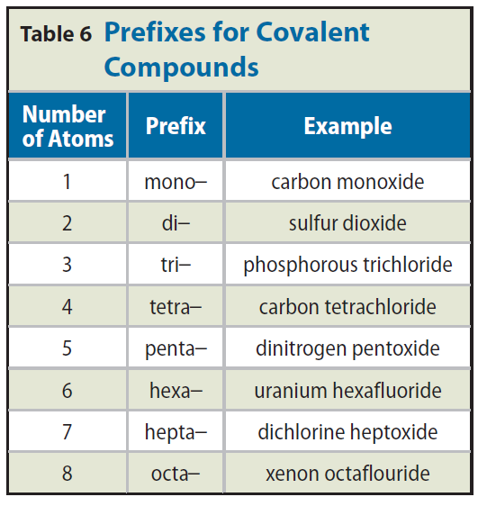
Using prefixes
These same prefixes are used when naming hydrates.
The main ionic compound is named the regular way, but the number of water molecules in the hydrate is indicated by the Greek prefix.
Writing Formulas and Naming Compounds
Copyright © McGraw-Hill Education

Slide 21
Prefixes for Covalent Compounds
Interactive Table
FPO Add link to Interactive Table animation from page 570here.
Writing Formulas and Naming Compounds
Copyright © McGraw-Hill Education

Slide 22
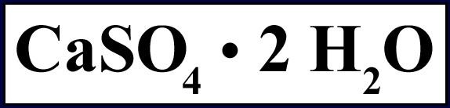
Compounds with Added Water
A hydrate is a compound that has water chemically attached to its ions and written into its chemical formula.
When a solution of cobalt chloride evaporates, pink crystals that contain six water molecules for each unit of cobalt chloride are formed. The formula for this compound is CoCl₂ • 6 H₂O.
When writing a formula that contains a hydrate, the number of water molecules is shown after a “·”. Following the number 2 is the formula for water as shown.
Writing Formulas and Naming Compounds
Copyright © McGraw-Hill Education

Slide 23
Review
Essential Questions
How are oxidation numbers determined?
How are formulas for ionic and covalent compounds written?
How are ionic and covalent compounds named?
Vocabulary
oxidation number
binary compound
polyatomic ion
hydrate
Writing Formulas and Naming Compounds
Copyright © McGraw-Hill Education

