Slide 1
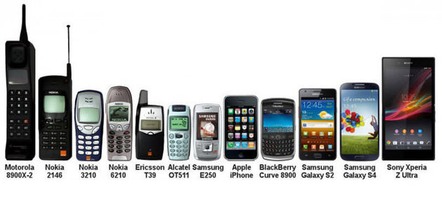
EVOLUTION

Slide 2
Evolution
Change in the gene pool of a population that results in successful change over time
Evolution can happen in various ways.

Slide 3
Change over time?
4.6 billion years ago : Earth formed
3.4 b-Prokaryotes
2.1 b-Eukaryotes
543 million years ago: multicellular organisms appear
200 million- first mammals
200 000 – first modern humans

Slide 4
Change over time?

Slide 5
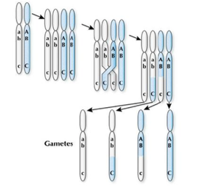
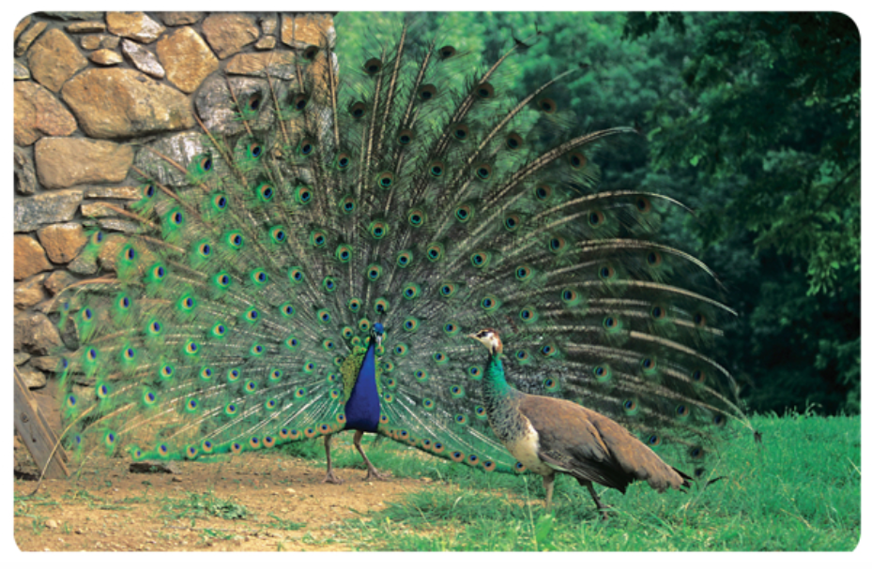
Recombination
The process by which genetic material from different individuals becomes combined.
Gene recombination during meiosis
Sexual reproduction

Slide 6
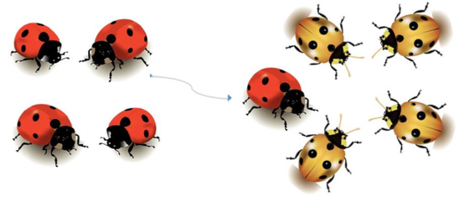
Gene Flow
The movement of genes into and out of a population due to interbreeding between different populations.

Slide 7
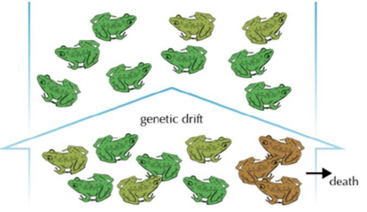
Genetic Drift
Random changes in the frequency of alleles within a gene pool; greater effect on small populations.

Slide 8
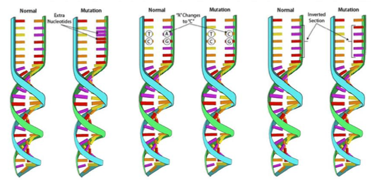
Mutation
Any change in the sequence of DNA; they can be beneficial, neutral, or harmful.

Slide 9
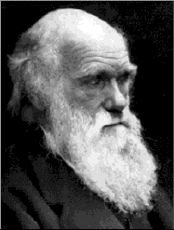
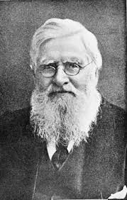
Natural Selection
Mechanism by which individuals that have inherited beneficial adaptations produce more offspring.
Idea proposed by Charles Darwin
and Alfred Wallace

Slide 10
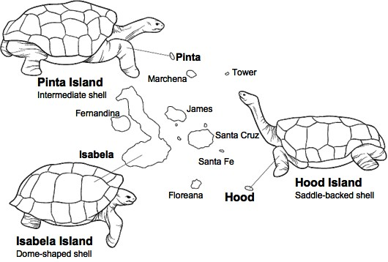
Charles Darwin
Traveled around the world between 1831-1836
Collected and made many observations on the species he encountered, especially the various Galapagos islands.
Was credited for
the idea of evolution
by natural selection.

Slide 11
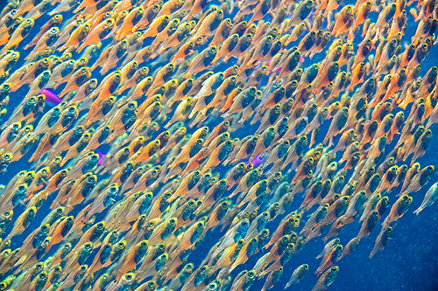
Mechanism of Natural Selection
Overpopulation
more individuals born than can survive

Slide 12
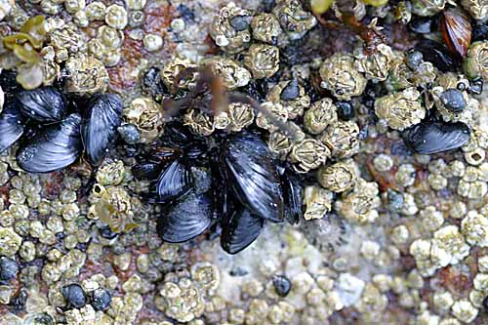
2. Competition
for limited resources
some will survive, some will not

Slide 13
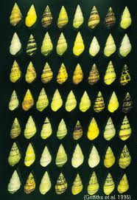
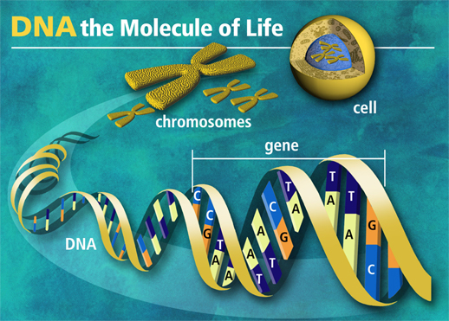
3. Variation
differences among individuals
a result of genetic
mutation – changes in
DNA

Slide 14
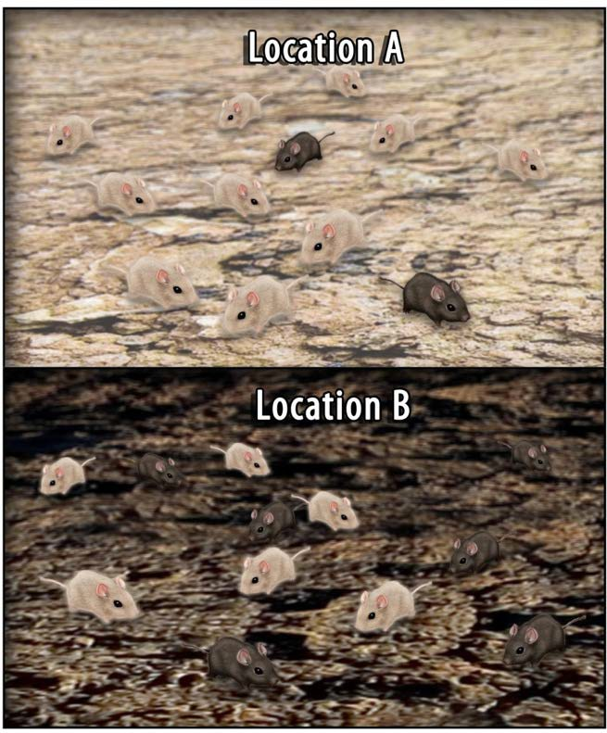
4. Adaptation (or not)
some variation gives some individuals a slight survival advantage

Slide 15
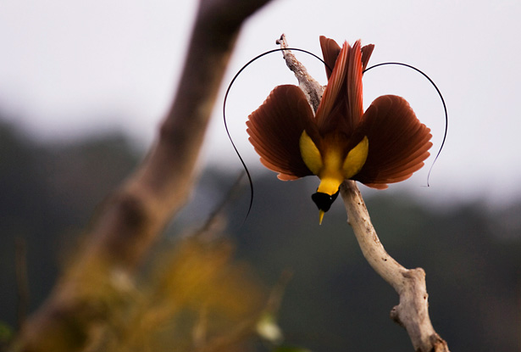
5. Reproduction (Descent with Modification)
those with best traits survive, reproduce and pass favorable traits on to their offspring

Slide 16
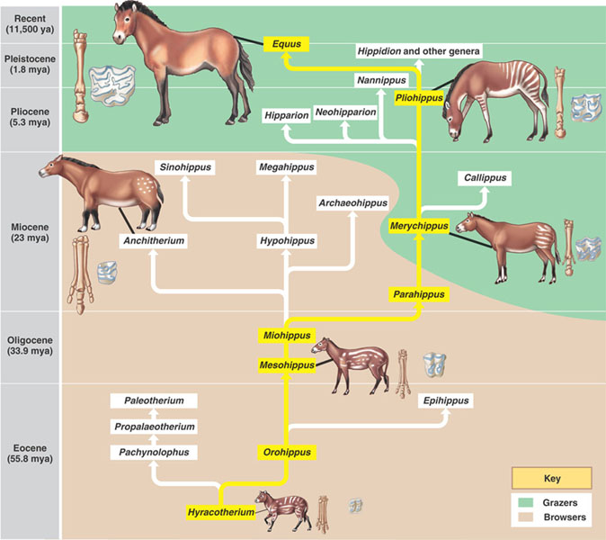
Species alive today are descendent with modifications from common ancestors.

Slide 17
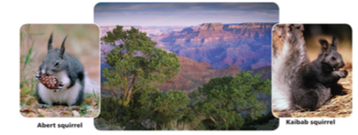
Types of Evolution
Divergent Evolution: Process by which an interbreeding species diverges into 2 or more species.

Slide 18
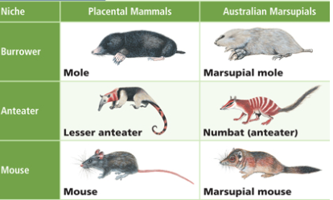
Types of Evolution
Convergent Evolution: Two unrelated species independently evolve similar traits.

Slide 19
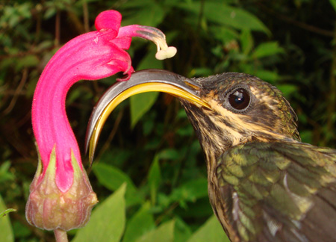
Types of Evolution
Co-Evolution: Evolution of 2 or more species, each adapting to changes in the other.

Slide 20
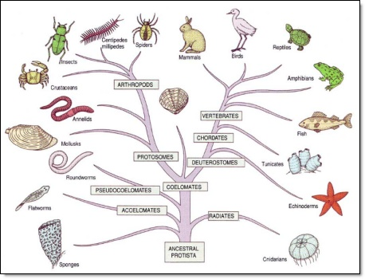
Types of Evolution
Microevolution: small-scale changes, change in allele(no change in kind of organisms)
Macroevolution: large-scale changes, can lead to evolution of new species and groups(change in kind of organisms)

Slide 21
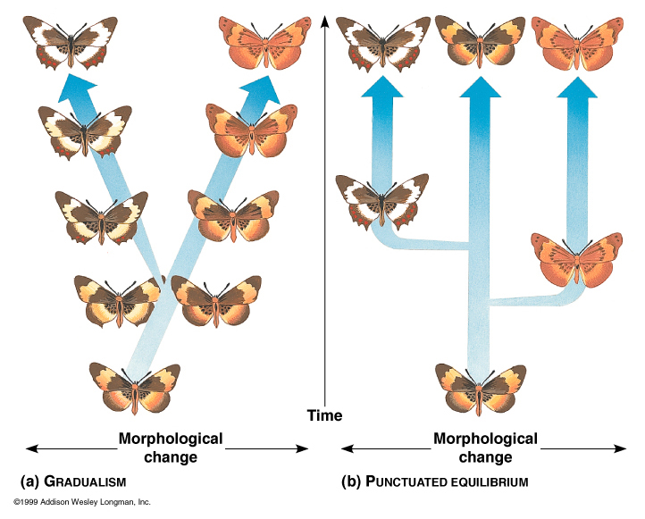
Changes and the Fossil Record
Gradualism: evolution generally occurs uniformly and by the steady and gradual transformation
Punctuated equilibrium: theory that speciation occurs in spurts of major genetic alterations that punctuate long periods of little change
Adaptive Radiation: Diversification of a species or single ancestral type into several forms that are each adaptively specialized to a specific environment

Slide 22
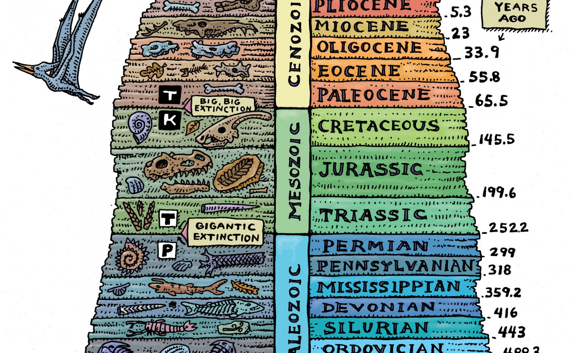
Changes and Fossil Records
Fossil Record: history of life as documented by fossils.
Sudden Appearance: organisms appear abruptly in the fossil record.
Stasis: period without change in the fossil record
Sequential nature: gradual change in fossils

Slide 23
Evidence of Common Ancestry Cellular and Molecular
1-Cell Theory
Cell is basic unit of life
Every life form is made of this basic structure
2-Organic Molecules
99% of all life is made of carbon, hydrogen, oxygen, nitrogen, phosphorous, & sulfur
Common usage of a small subset of over 90 available elements for living things

Slide 24
Evidence of Common Ancestry Cellular and Moleculare
3-DNA
Genetic informational molecule in every organism, including viruses
DNA language (genetic code) is universal
Common genetic language allows for insertion of human genes in bacteria to produce human proteins
4-ATP
primary energy molecule for every organism

Slide 25
Evidence of Common Ancestry Natural Selection
1-Artificial selection
Humans have selected (breed) animals for certain characteristics (looks, number of eggs produced, wheat yields)
2-Biogeography – geographic distribution of species can show how organisms are related
Flightless birds found in Africa, South American, and Australia. It is thought that all 3 had a common ancestor before the tectonic plates moved (continental drift)
Marsupial mammals – this concept explains why they developed in Australia (separated from placental mammals found on other continents)

Slide 26
Evidence of Common Ancestry Natural Selection
3-Fossils – preserved remains of dead organisms
Paleontologist - is the study of prehistoric life, includes the study of fossils
Darwin termed evolution “descent with modification”
Fossil records provide valuable information about evolutionary changes or modifications in organisms
Estimate age of fossil by location in sedimentary rock (relative dating) and radiometric isotope techniques (absolute dating)
Molecular clocks – look at changes in portions of genomes of organisms; also used to help determine the age of evolutionary events

Slide 27
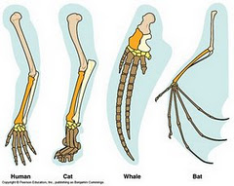
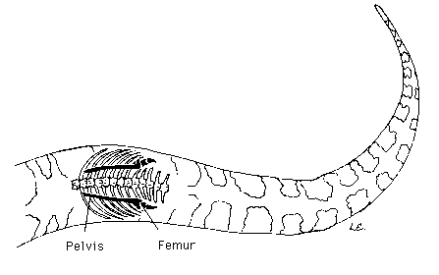
Evidence of Common Ancestry
4-Homologies (Homologous Structures)
Anatomical similarities of related life forms
Example: forelimbs of vertebrates made of same basic bones but have different functions based on environment
5-Vestigial structures – are the remains of non-functional structures
Example – pelvic bones in modern whales and snakes

Slide 28
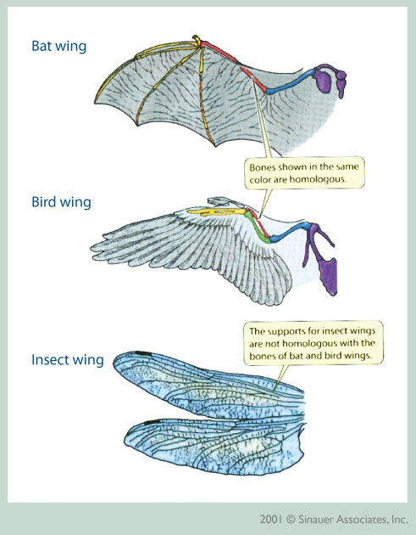
Evidence of Evolution
6-Analogous structures - Some biological characteristics are analogous (also called "convergent"), which means that they serve the same function in different species but they evolved independently rather than from the same embryological material or from the same structures in a common ancestor. An example of an analogous structure would be the wings on butterflies, bats, and birds.

Slide 29
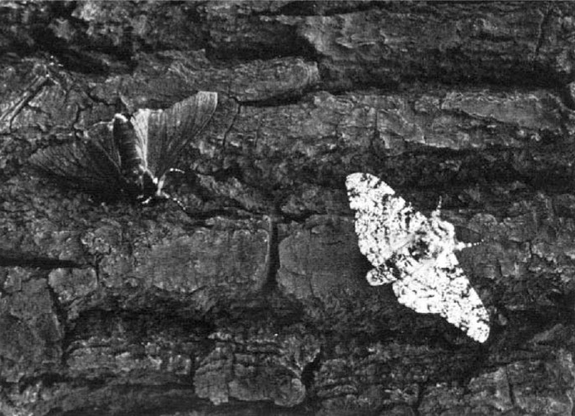
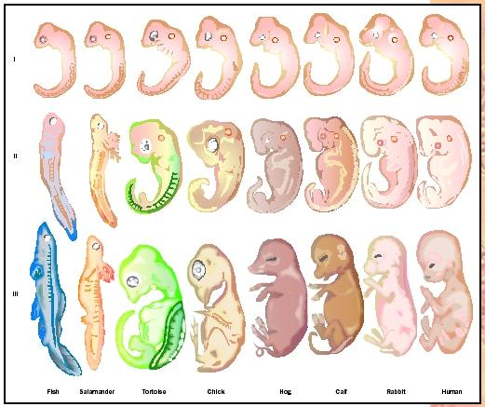
Evidence of Evolution
7-Variations in Life
In England, the peppered moth shifted from predominantly light coloring to dark when air pollution darkened the trees that it lives on
8-Comparative anatomy of adults – visual similarities in adult vertebrate (eyes, ears, mouth, nose, appendages
9-Comparative embryology – early developmental stages of humans share remarkably similar vertebrate characteristics that either disappear or become vestigial in human adults

