Slide 1
EVOLUTION AND BIODIVERSITY
AP BIOLOGY 2015-16

Slide 2
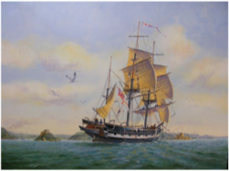
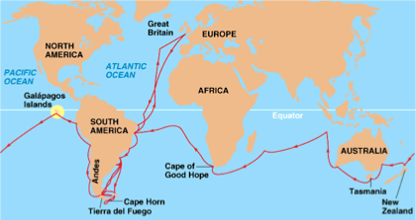
CHARLES DARWIN (1809-1882)
Naturalist; made the “Voyage of the Beagle” in 1831
studied adaptations in plants and animals in the diverse
ecosystems and noticed distinctions from European relatives
wrote the “Origin of the Species”

Slide 3
DARWIN’S TWO KEY POINTS
1)Species of organisms inhabiting Earth
today descend from ancestral species
2)Mechanism of evolution is “natural
selection”
**DESCENT WITH MODIFICATION**

Slide 4
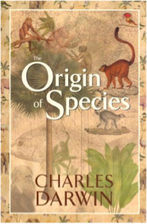
NATURAL SELECTION
competition for limited resources results in differential survival.
individuals with more favorable phenotypes (adaptations) are more likely to survive and produce more offspring, thus passing traits to subsequent generations.
evolutionary fitness is measured by reproductive success.

Slide 5
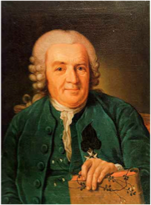
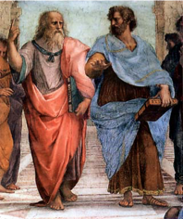
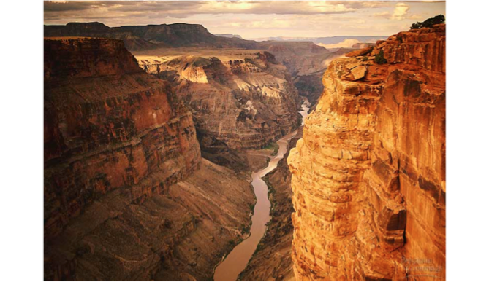
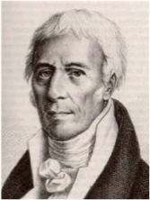
HISTORICAL CONTEXT OF EVOLUTION
Plato (427-347 BC)
Aristotle (384-322 BC)
Judeo-Christian culture
Carolus Linnaeus
Georges Cuvier (1820’s)
James Hutton (1780’s)
Charles Lyell (1860’s)
Jean- Baptiste de Lamarck
Alfred Wallace

Slide 6
KEEP THIS IN MIND!!
Population- group of interbreeding individuals belonging to a particular species and sharing a common geographic area
SMALLEST UNIT THAT CAN EVOLVE!
Amplifies or diminishes heritable variations ONLY
Evolution is situational! (Factors vary from place to place)

Slide 7
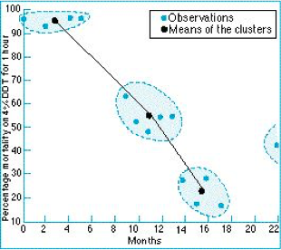
HOW NATURAL SELECTION CAN PROVIDE
EVIDENCE FOR EVOLUTION
insecticide resistance
overuse of antibiotics

Slide 8
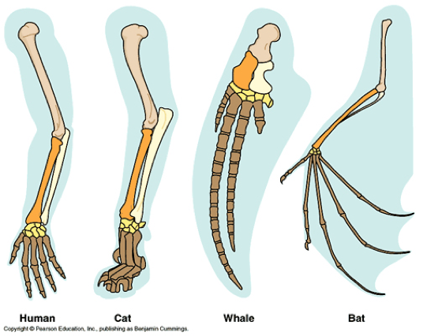
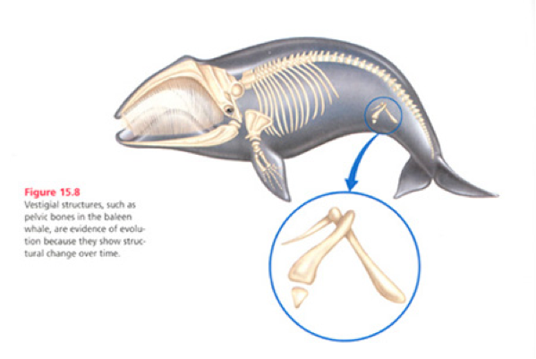
EVIDENCE FOR EVOLUTION
homologous structures
vestigial structures

Slide 9
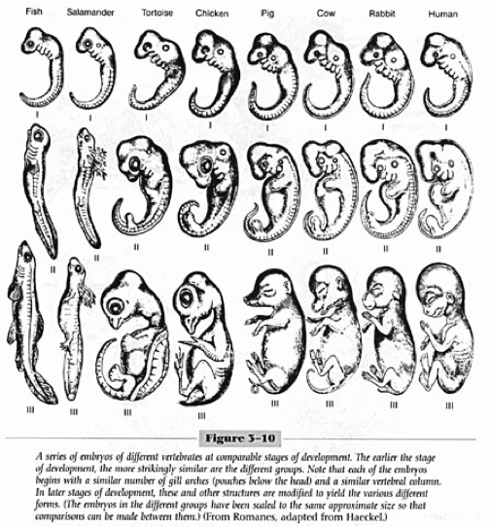
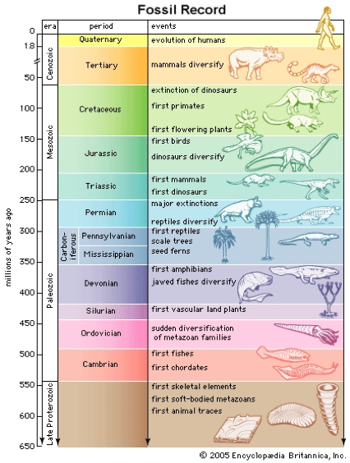
EVIDENCE FOR EVOLUTION
embryology
fossil record

Slide 10
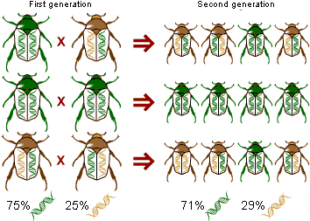
MICROEVOLUTION
change in the genetic makeup of a population over time
gene pool = total genes (alleles) in a population

Slide 11
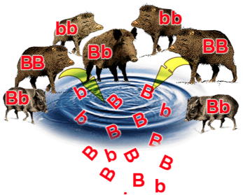
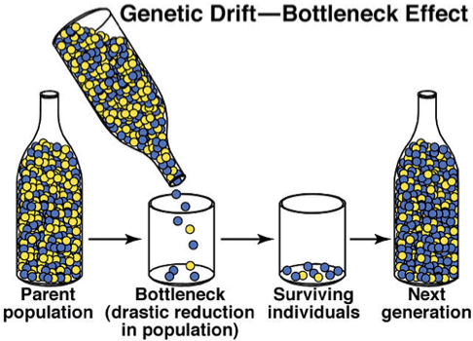
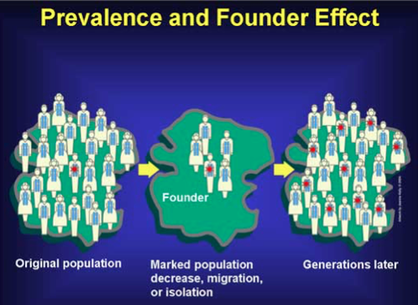
FOUR MODES OF EVOLUTION
genetic drift
founder effect
bottleneck effect
gene flow
immigration and emigration
mutations
natural selection

Slide 12
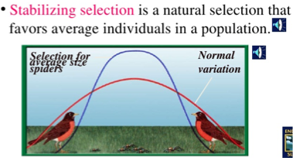
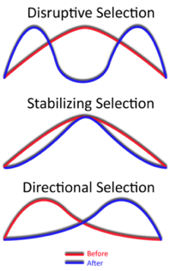
MODES OF SELECTION

Slide 13
HARDY-WEINBERG THEOREM
Used to describe a population that is NOT evolving.
frequencies of alleles and genes in a population’s gene pool will remain constant over the course of generations unless they are acted upon by forces.

Slide 14
CONDITIONS FOR H-W TO BE MET
1. a large population size
2. absence of migration
3. no net mutations
4. random mating
5. absence of selection

Slide 15
HARDY-WEINBERG EQUATION
p + q = 1 and p² + 2pq + q² = 1

Slide 16
MORE ON NATURAL SELECTION
environments change and act as selective mechanisms on populations
phenotypic variations are not directed by environment but occur through random changes in the DNA and through new gene combinations.
some phenotypic variations significantly increase or decrease fitness of the organism and the population

Slide 17
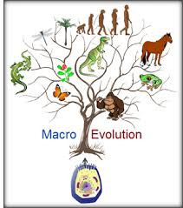
MACROEVOLUTION
the big picture
study of evolution of groups of species over long periods of time.

Slide 18
WHAT IS A SPECIES?
Biological Species Concept: a species as a population (or group of populations) whose members have the potential to interbreed with one another in nature producing viable, fertile offspring, but who cannot with members of other species

Slide 19
REPRODUCTIVE ISOLATION
Any factor that impedes two species from producing viable, fertile hybrids contributes to reproductive isolation.
Prezygotic barriers: impede mating between species or hinder the fertilization of ova if members of different species attempt to mate
Postzygotic barriers: prevent hybrid zygote from developing into viable, fertile adult

Slide 20
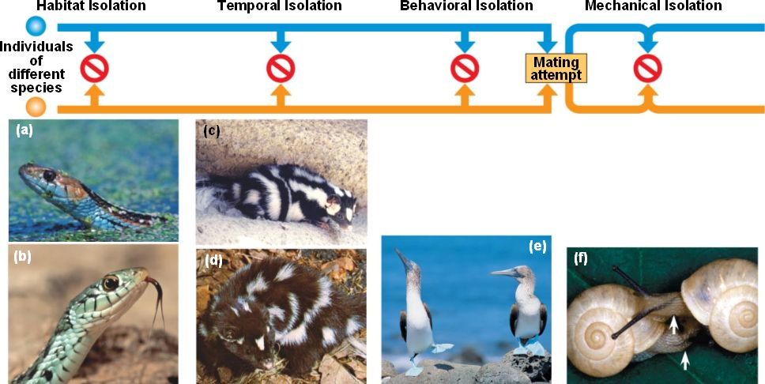

Slide 21
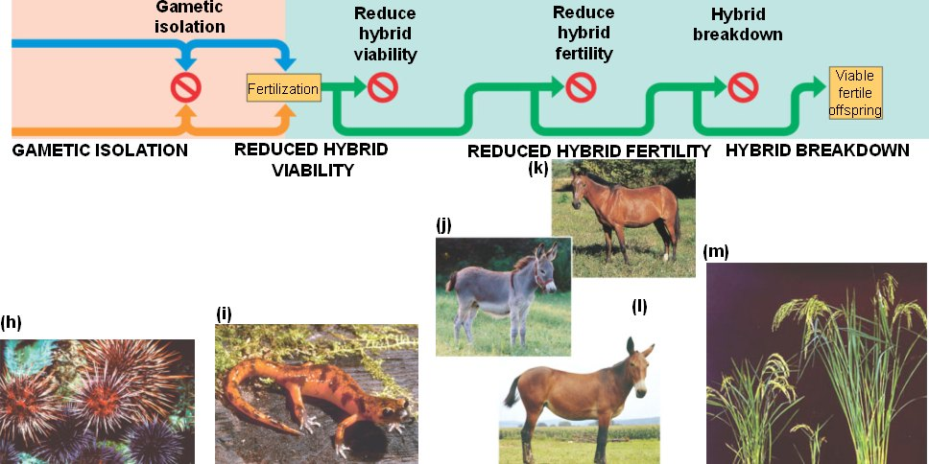

Slide 22
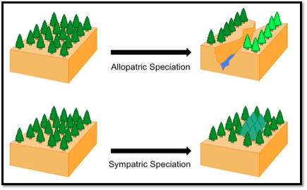
MODES OF SPECIATION

Slide 23
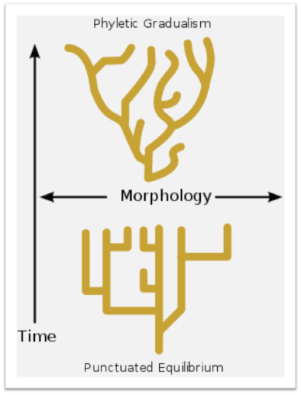
DEBATE OVER MACROEVOLUTION
Gradualism: evolutionary change is steady, slow process
Punctuated Equilibrium: changes occur in rapid bursts separated by long periods of stasis (no change)

Slide 24
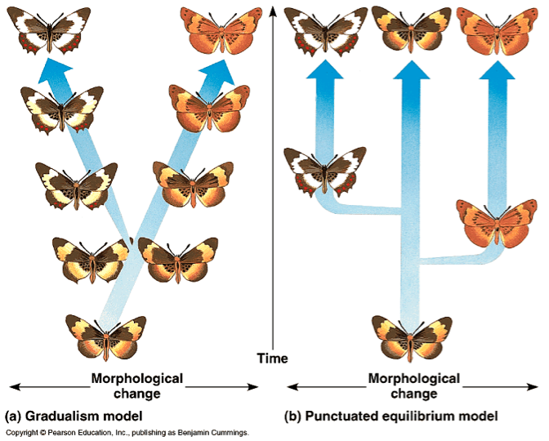

Slide 25
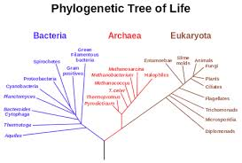
PHYLOGENY
the evolutionary history of a species or a group of related species

Slide 26
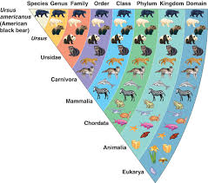
TAXONOMICAL HIERARCHY
Domain
Kingdom
Phylum
Class
Order
Family
Genus
Species

Slide 27
FOSSIL RECORD
Ordered array in which fossils appear within layers, or strata, of sedimentary rocks that mark the passing of geologic time
Relative Dating- rock record, chronic
Geologic Time Scale
Absolute Dating
Radiometric Dating: measure of radioactive isotopes in fossils or rocks

Slide 28
SYSTEMATICS
phylogenetic systematics - deals with identifying and understanding the evolutionary relationships among the many different kinds of life on earth, both living (extant) and dead (extinct).
relationships established by phylogenetic systematics often describe a species' evolutionary history.

Slide 29
CLADISTICS
members of a group share a common evolutionary history, and are "closely related," more so to members of the same group than to other organisms.
these groups are recognized by sharing unique features which were not present in distant ancestors.
these shared derived characteristics are called synapomorphies.

Slide 30
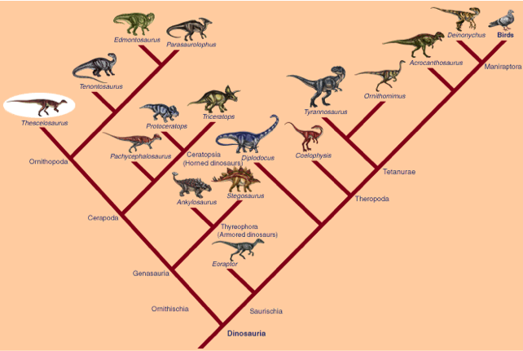

Slide 31
SORTING OF HOMOLOGY AND ANALOGY

Slide 32
CONSERVED CORE PROCESSES
Structural and functional evidence supports the relatedness of all domains.
DNA and RNA are carriers of genetic information through transcription, translation and replication.
Major features of the genetic code are shared by all modern living systems.
Metabolic pathways are conserved across all currently recognized domains

Slide 33
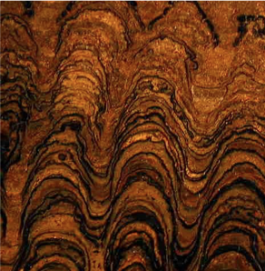
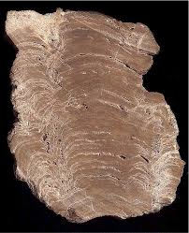
CURRENT THOUGHT ON
HISTORY OF EARTH
≅ 4.6 billion years old
life originated ≅ 3.5 bya
“bombardment” ended 3.9 billion years ago
prokaryotes dominated until 2 bya
oxygen began accumulating 2.7 bya
eukaryotes arose 2.1 bya
multicellular eukaryotes 1.2 bya

Slide 34
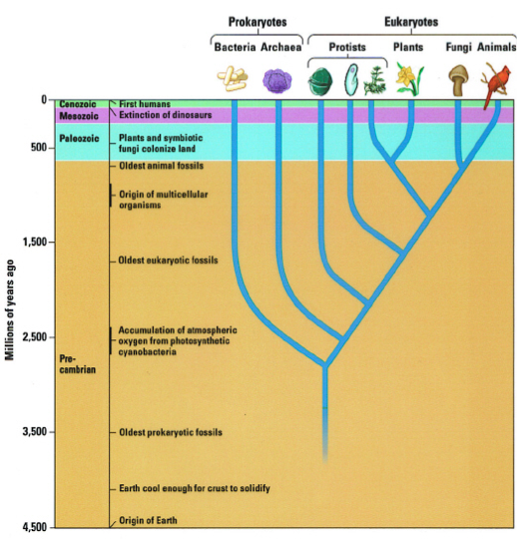

Slide 35
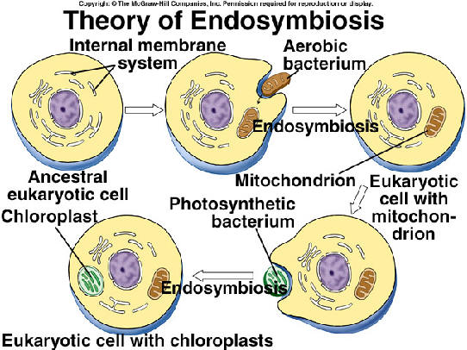
ENDOSYMBIOTIC THEORY

