Slide 1
BIOCHEMISTRY
LRHS BIOLOGY
2015-16

Slide 2
Learning Objectives
We will describe and compare the structures and functions of the 4 major biomolecules: carbohydrates, lipids, proteins, and nucleic acids.
I will use Cornell notes, and a graphic organizer to describe & compare the structures and functions of the 4 major biomolecules: carbohydrates, lipids, proteins, and nucleic acids.

Slide 3
Key Vocabulary Words
Biomolecule
Macromolecule
Monomer
Polymer
Organic
inorganic
Hydrolysis
Amino acids
Saccharide
Fatty acids
Lipids
Nucleic acids
Protein
Carbohydrate
Peptide bond

Slide 4
AGENDA
Bell Ringer
Hook: blocks
Writing Cornell Notes: Format & Overview
Biomolecules Notes
Exit Ticket: Graphic Organizer ex. Table, Bubble map, etc.

Slide 5
Hook
With your table partners use the cubes to create represent the following:
1. A Single chain
2. a chain with 3 tails of equal length
3. a ladder like chain

Slide 6
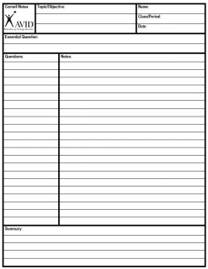
Cornell Notes Format

Slide 7
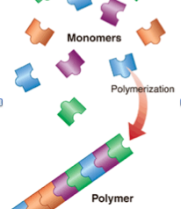
MACROMOLECULES
Macromolecules – “Giant molecules” made from smaller molecules
Formed by a process known as polymerization, in which large compounds are built by joining smaller ones together.
The smaller units, or monomers, join together to form polymers.

Slide 8
Polymers
Artificial polymers include such plastics as polyethylene, styro foam, and Saran wrap; fibers such as nylon, Dacron (polyester), and rayon; and other materials such as Formica, Teflon, and PVC pipe.

Slide 9
KEY WORDS
Cornell Notes
Essential Questions
Ex. What are macromolecules?
How does polymerization occur?
Macromolecule “aka”
Biomolecule
Polymerization
Monomer
Polymer

Slide 10
Four types of Macromolecules (organic compounds)
Biological molecules ‘AKA” Macromolecules
Carbohydrates
Lipids
Proteins
Nucleic Acids
So..How are macromolecules made? How are they broken down into their____?

Slide 11
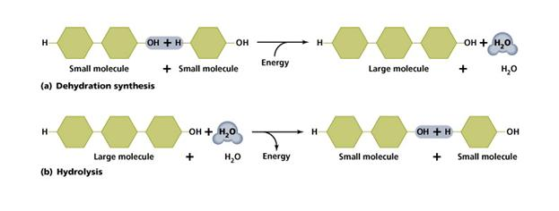
BUILDING AND DIGESTING MACROMOLECULES
Removal of H2O
Addition of H2O

Slide 12
ORGANIC MOLECULES
Let’s compare the structure & functions of these Four groups of organic compounds found in living things:
Carbohydrates
Lipids
Nucleic Acids
Proteins
Cornell Notes
Essential Questions
Structure-What are they made up of ( which monomers)?
Functions-What are their uses?
-What are examples?

Slide 13
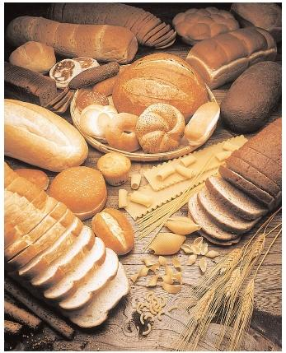
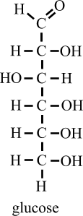
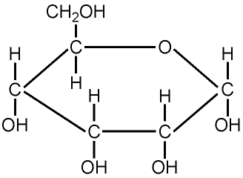
CARBOHYDRATES
CarbOhydrates - Compounds made up of carbon, hydrogen, and oxygen atoms
Usually in a ratio of 1 : 2 : 1.

Slide 14
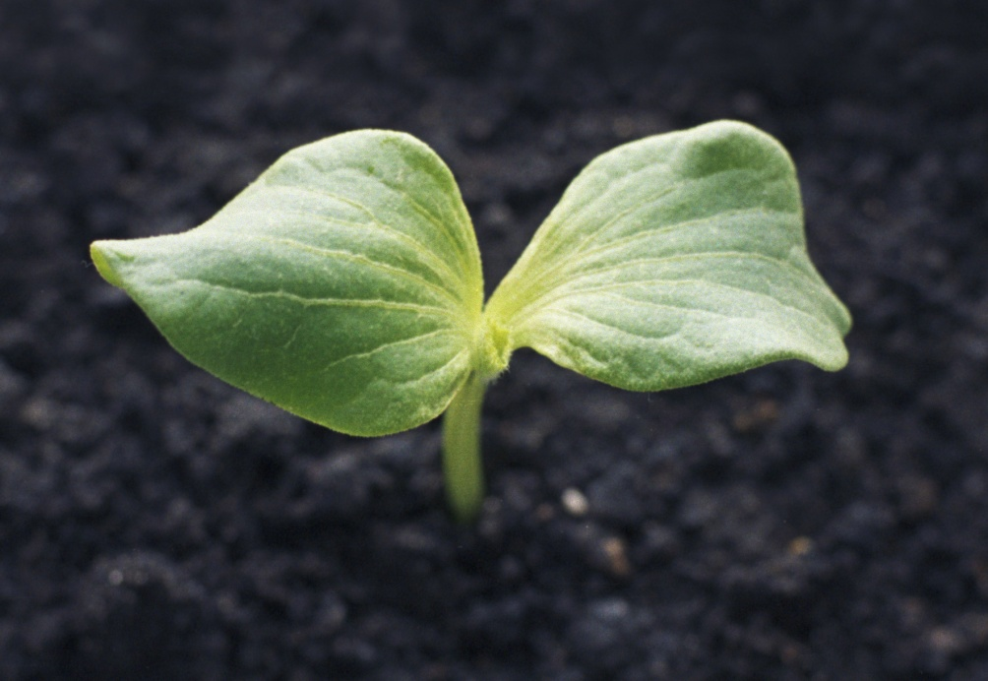
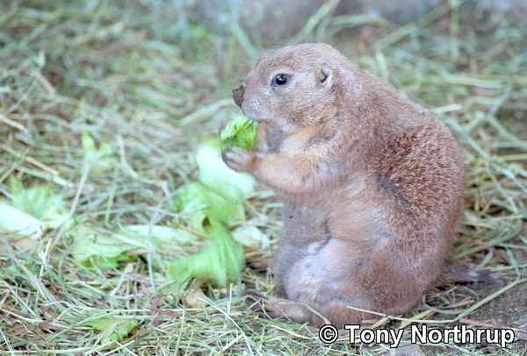
Uses of Carbohydrates
Living things use carbohydrates as:
Main source of energy (starches and sugars)
Plants and some animals also use carbohydrates for structural purposes

Slide 15
Uses of Carbohydrates
Animals
Store excess sugar in the form of glycogen
Plants
Store excess sugar in the form of starch
Use tough, flexible cellulose fibers to give them their strength and rigidity

Slide 16
Sugars are put into 3 categories:
Monosaccharides - Single sugar molecules
Examples: Glucose, Galactose, Fructose
Disaccharides – Double sugar molecules
Examples:
Glucose + Fructose = Sucrose
Glucose + Galactose = Lactose
Glucose + Glucose = Maltose
Polysaccharides – More than two sugar molecules
Examples: Starch, Cellulose, Chitin, Glycogen

Slide 17
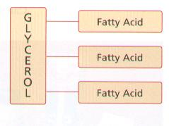
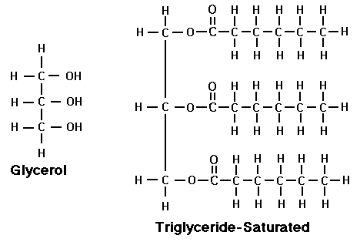
Structure of Lipids
Made up mostly from carbon and hydrogen atoms
Glycerol molecule + 3 fatty acids
In your Hook: Which building block was your lipids?

Slide 18
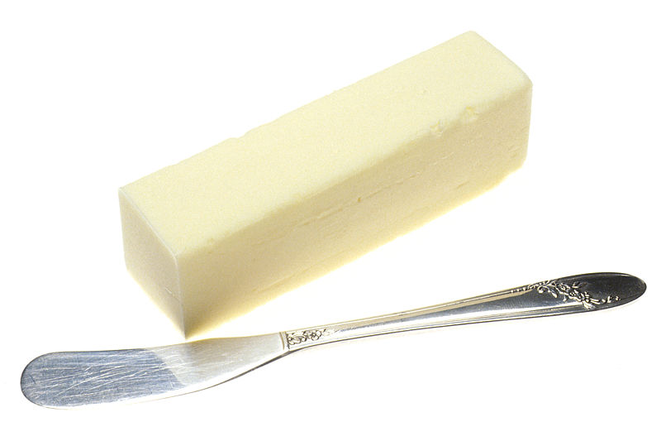
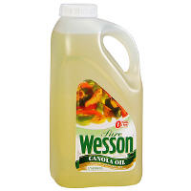
LIPIDS
Common categories of lipids are
Fats
Oils
Waxes
Functions:
Can be used to store energy
Some lipids are important parts of biological membranes and waterproof coverings
Can serve as chemical messengers (steroids only)
Generally not soluble in water

Slide 19
Saturated and Unsaturated Lipids
Saturated - If each carbon atom in a lipid's fatty acid chains is joined to another carbon atom by a single bond.
“saturated” is used because the fatty acids contain the maximum possible number of hydrogen atoms
Unsaturated - If there is at least one carbon-carbon double bond in a fatty acid.
Examples - Corn oil, sesame oil, canola oil, and peanut oil

Slide 20
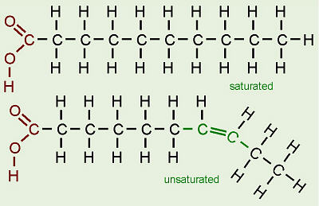
Learning Check
Which one of these fatty acids are Saturated and which is Unsaturated?

Slide 21
Learning Check
Which one of these fatty acids are Saturated and which is Unsaturated?

Slide 22
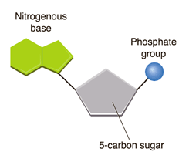
Nucleic Acids
Nucleic acids - Macromolecules containing hydrogen, oxygen, nitrogen, carbon, and phosphorus.
Made up of repeating units called nucleotides
Each nucleotide contains:
5-Carbon Sugar
Phosphate Group
Nitrogenous Base

Slide 23
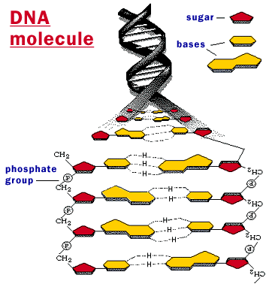
Nucleic Acids
Which building block was this?
Function:
Store genetic information
Transmit genetic information
Made up of :
Nucleotides
Phosphate backbone
Two Kinds of Nucleic Acids:
Ribonucleic acid (RNA)
Contains the sugar ribose
Deoxyribonucleic acid (DNA)
Contains the sugar deoxyribose

Slide 24
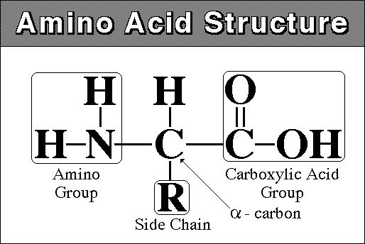
Protein
Proteins - Macromolecules that contain nitrogen as well as carbon, hydrogen, and oxygen.
Made up of chains of amino acids folded into complex structures.
Amino Acids - Compounds with an amino group (−NH2) on one end and a carboxyl group (−COOH) on the other end.
What are the monomers of protein called?

Slide 25
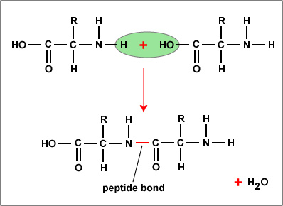
Amino Acids
There are only 20 different amino acids.
Any amino acid may be joined to any other amino acid by bonding an amino group to a carboxyl group.
This bond is called a peptide bond.

Slide 26
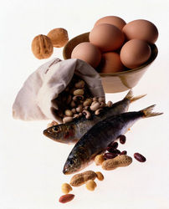
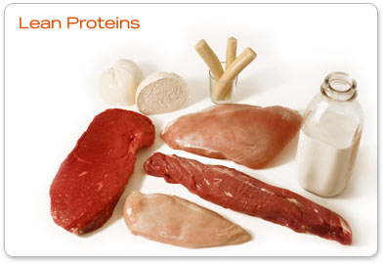
Functions of Proteins
Each protein has a specific role.
Some proteins control the rate of reactions and regulate cell processes.
Some are used to form bones and muscles.
Others transport substances into or out of cells or help to fight disease.

Slide 27
Product/Extension
In your unit Guide,
Complete Chapter 2 Questions 1, 2, & 3

Slide 28
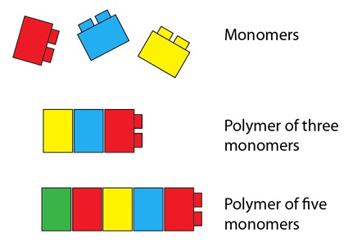
Example Analogy for polymer
A polymer is like a freight train with many cars. Each car is a monomer.
A polymer is like a string of pearls. Each pearl is a monomer.

Slide 29
Homework
Complete Summary Section of Today’s Cornell Notes.

Slide 30
STOP!

