Slide 1
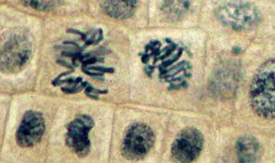
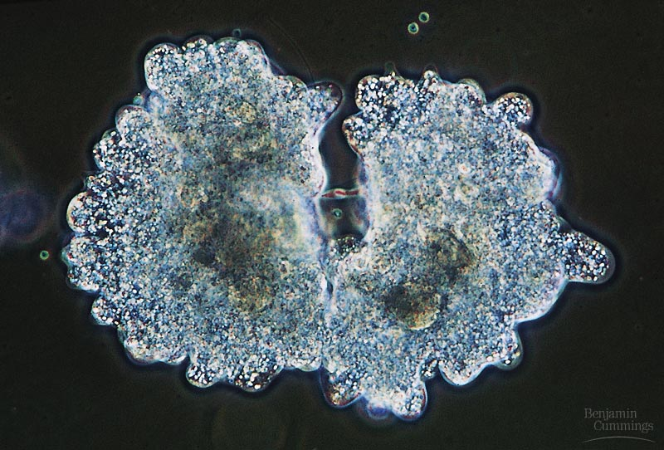
Biology is the only subject in which multiplication is the same thing as division…
2007-2008
Notes:
1

Slide 2
Uses of Mitosis
Growth
  Organisms grow by increasing number of cells, not cell size
Tissue Repair
  Wounds close by creating cells identical to those that were lost or injured
Embryonic Growth
  Increasing cell number
Asexual Reproduction (Binary Fission)
  Creating whole new organisms only through mitosis

Slide 3
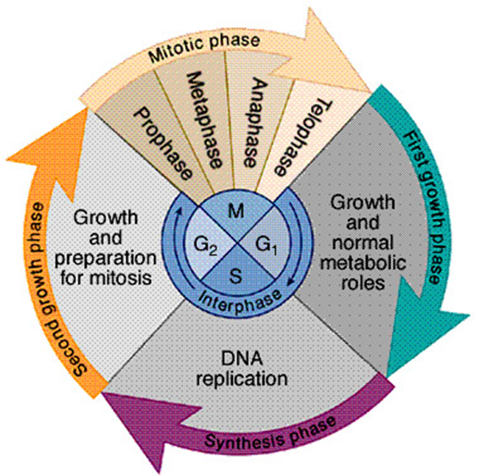
Stages of the Cell Cycle
Mitotic Phase
  Refers to the process of nuclear division
Cytokinesis
  The actual physical division of the cell
  Not included in the mitotic phase
  Division of the cytoplasm and its contents
Interphase
  Stage G1
    Period of cell growth
    Cell increases number of organelles
  Stage S
    DNA replication
  Stage G2
    Preparation for mitosis

Slide 4
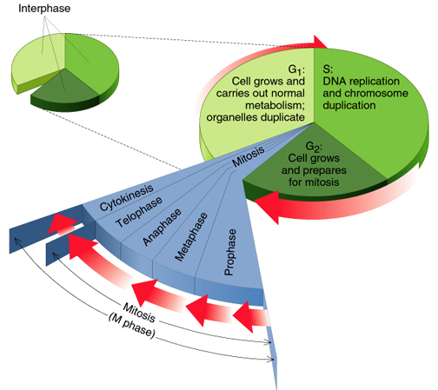
*Make sure you know what happens at each stage of Interphase!

Slide 5
Cell cycle
Cell has a “life cycle”
cell is formed from
a mitotic division
cell grows & matures
to divide again
cell grows & matures
to never divide again
G₁, S, G₂, M
liver cells
G₁→G₀
epithelial cells,
blood cells,
stem cells
brain / nerve cells
muscle cells
Notes:
5

Slide 6
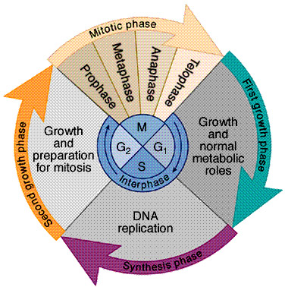
Interphase (longest stage of cell’s life)
Divided into 3 phases:
  G₁ = 1st Gap
    cell doing its “everyday job”
    cell grows
  S = DNA Synthesis
    copies chromosomes
  G₂ = 2nd Gap
    prepares for division
    cell grows (more)
    produces organelles,
    proteins, membranes
G₀
signal to divide
Notes:
6

Slide 7
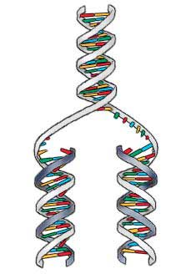
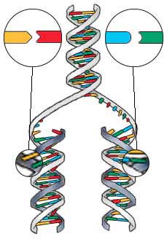
S-Phase of Interphase
Dividing cell replicates DNA
  must separate DNA copies correctly to 2 daughter cells
    human cell duplicates ~3 meters DNA
    each daughter cell gets complete
    identical copy
    error rate = ~1 per 100 million bases
      3 billion base pairs in mammalian genome
      ~30 errors per cell cycle
        mutations (to somatic cells)

Slide 8
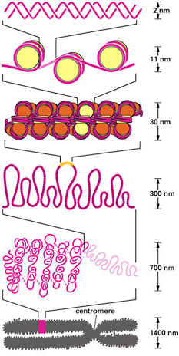
Organizing DNA
ACTGGTCAGGCAATGTC
DNA is organized in chromosomes
  double helix DNA molecule
  wrapped around histone proteins
    like thread on spools
  DNA-protein complex = chromatin
    organized into long thin fiber
  Condensed further during mitosis (prophase)

Slide 9
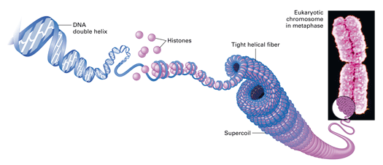
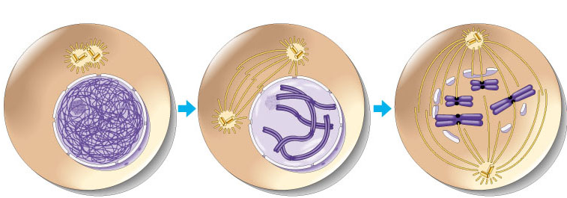
Copying DNA & packaging it…
After DNA duplication, chromatin condenses
  coiling & folding to make a smaller package

Slide 10
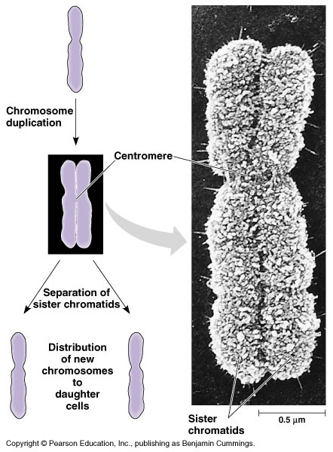
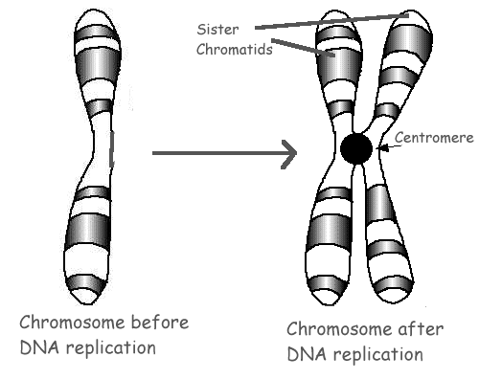
Mitotic Chromosome
Duplicated chromosome
  2 sister chromatids
  narrow at centromeres
  contain identical
  copies of original DNA
Notes:
Centromeres are segments of DNA which have long series of tandem repeats = 100,000s of bases long. The sequence of the repeated bases is quite variable. It has proven difficult to sequence.

Slide 11
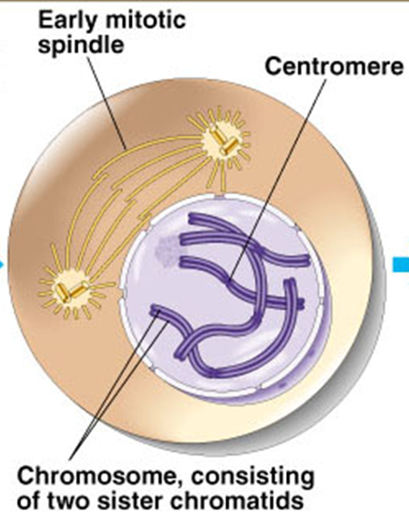
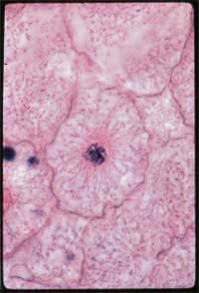
Prophase
Chromosomes become visible due to supercoiling
Centrioles move to opposite poles
Spindle forms from centriole
Nucleolus becomes invisible
  Nuclear membrane breaks down – why?

Slide 12
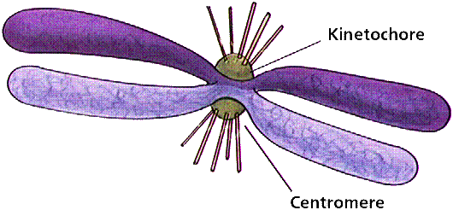
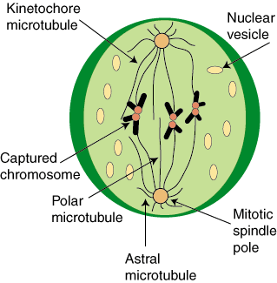
Transition to Metaphase
Prometaphase
  spindle fibers attach to centromeres of sister chromatids
    creating kinetochores
  chromosomes begin moving to the middle

Slide 13
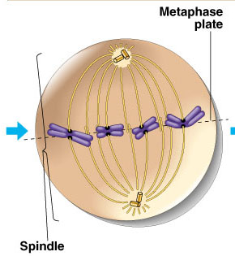
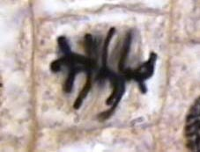
Metaphase
Chromosomes move to the equator of the cell
Helps to ensure chromosomes separate properly
    so each new nucleus receives only 1 copy of each chromosome

Slide 14
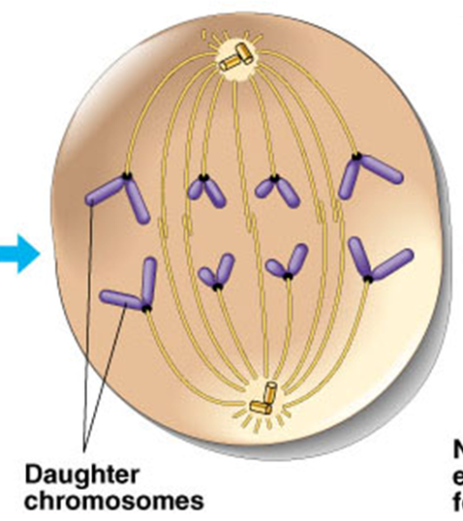
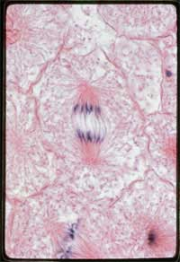
Anaphase
Sister chromatids separate at kinetochores
  move to opposite poles
  pulled at centromeres by motor proteins “walking” along microtubules
    increased production of
    ATP by mitochondria to fuel this process

Slide 15
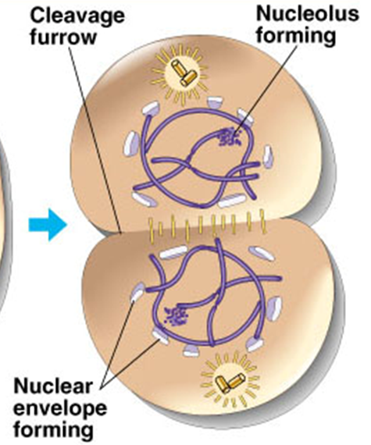
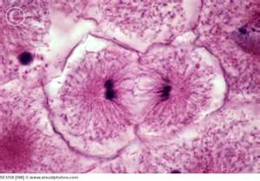
Telophase
Chromosomes arrive at the poles
Spindle disappears
Centrioles replicate (in animal cells, why not plants?)
Nuclear membrane reappears
Nucleolus becomes visible
Chromosomes become chromatin (uncoiling)

Slide 16
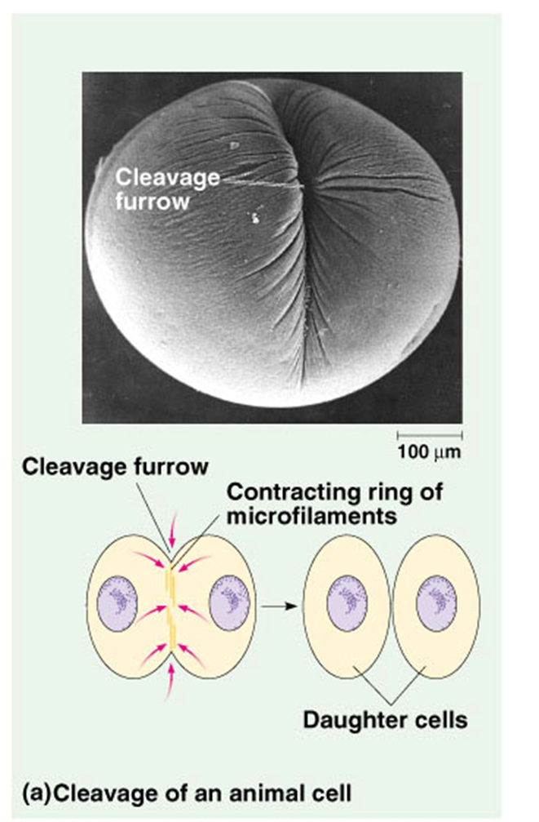
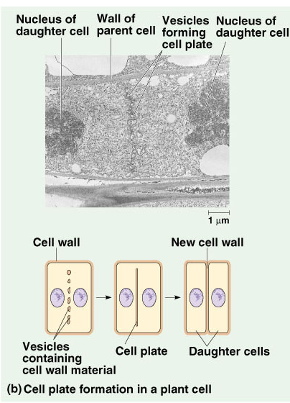
Cytokinesis
Animals
    cleavage furrow forms
    splits cell in two
    like tightening a draw string
Plants
  cell plate forms
    vesicles line up at equator and fuse
Notes:
Division of cytoplasm happens quickly.

Slide 17
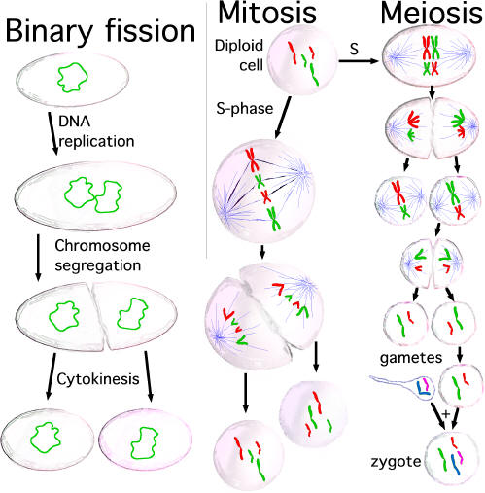
Evolution of mitosis
Mitosis in eukaryotes
likely evolved from binary fission in bacteria
  single circular chromosome
  no membrane-bound organelles
Notes:
17

