Slide 1
PLANTS PPT 2016

Slide 2
Plant organs are made of three tissue systems.
Dermal tissue covers the outside of a plant.
protects the plant
secretes cuticle of leaves
forms outer bark of trees
Ground tissue is found inside
provides support
stores materials in roots and stems

Slide 3
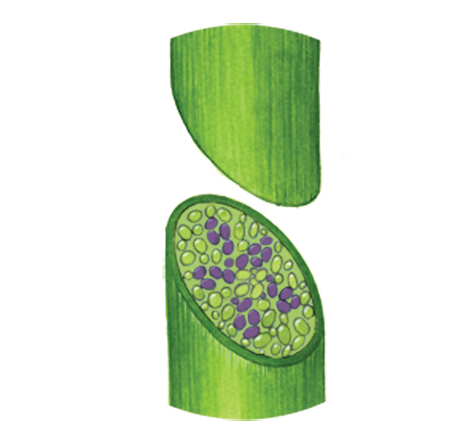
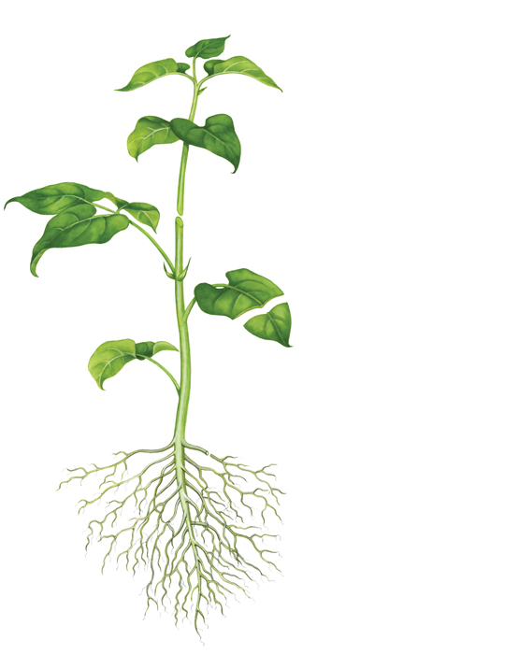
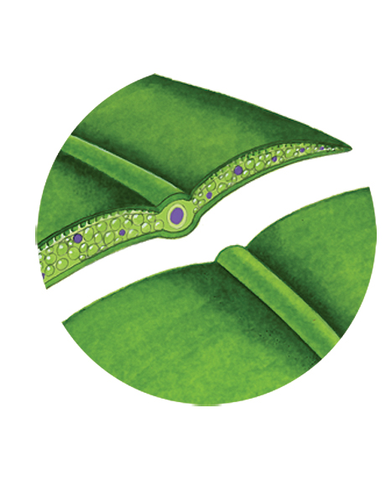
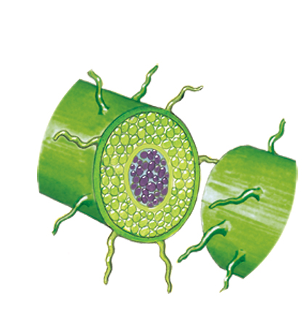
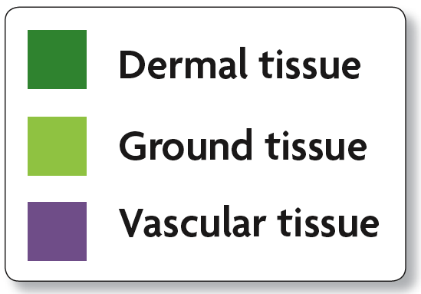
Vascular tissue transports water, minerals and organic compounds.
two networks of hollow tubes
xylem transports water and minerals
phloem transports photosynthetic products
stem
leaf
root

Slide 4
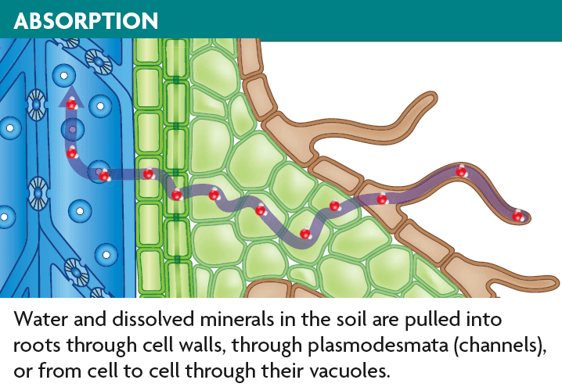
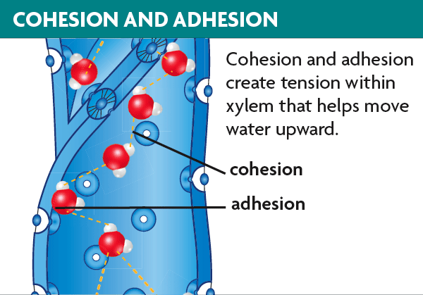
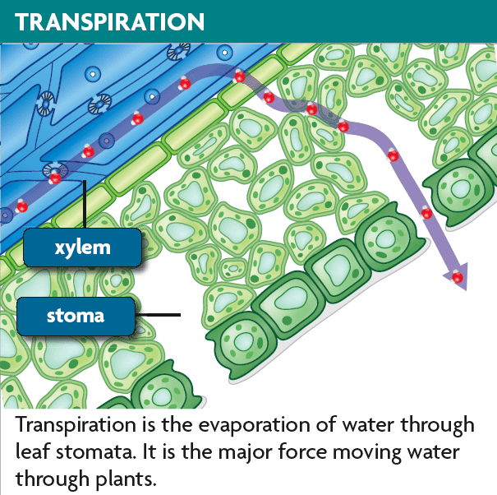
Water travels from roots to the top of trees.
absorption occurs at roots
cohesion and adhesion in xylem
transpiration at leaves

Slide 5
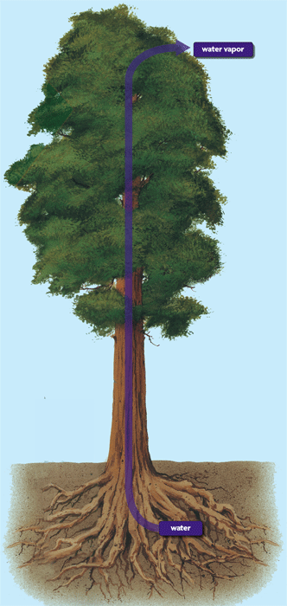
Transpiration is the loss of water vapor through leaves.
water vapor exits leaf stomata
helps pull water to the top branches

Slide 6
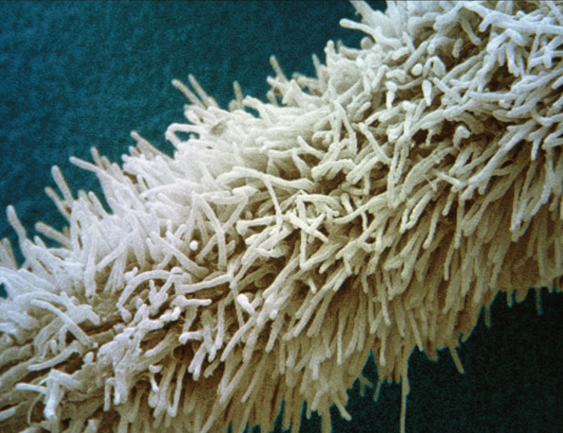
Roots anchor plants and absorb mineral nutrients from soil.
Roots provide many functions.
support the plant
absorb, transport, and store nutrients
root hairs help absorption

Slide 7
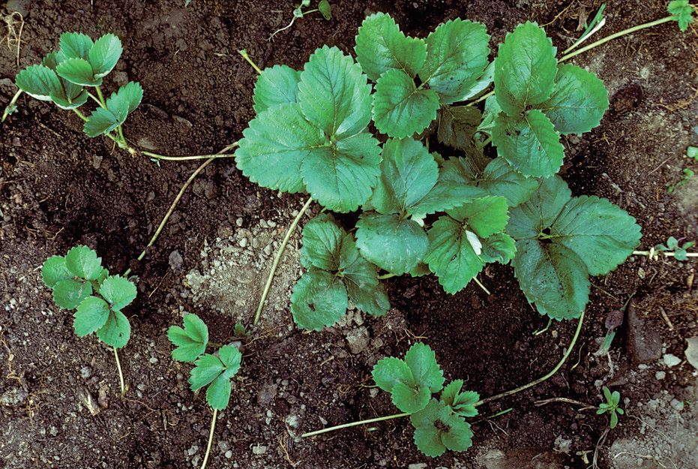
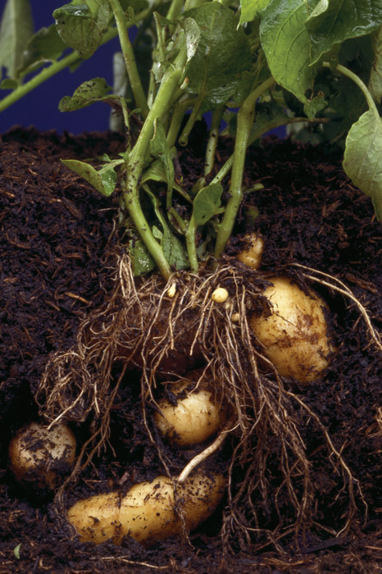
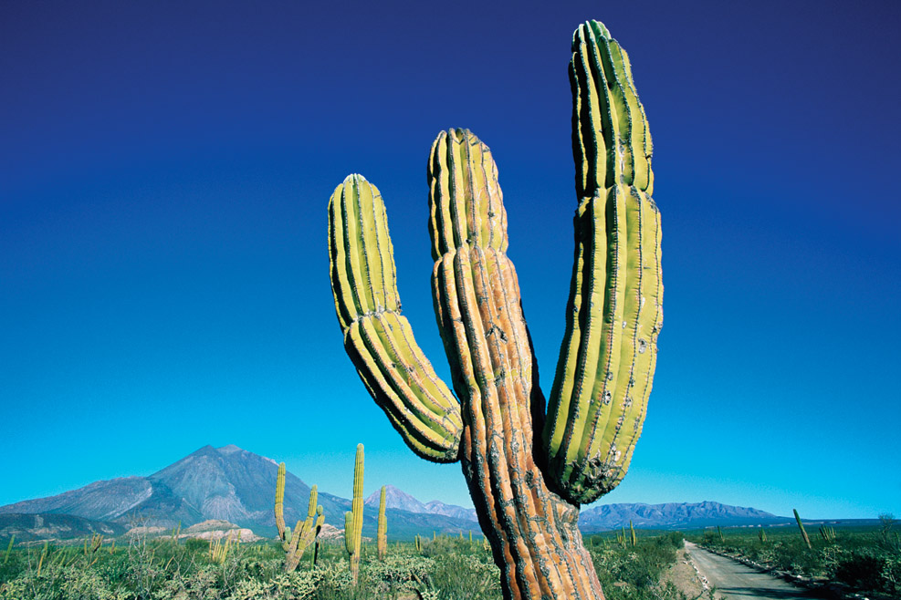
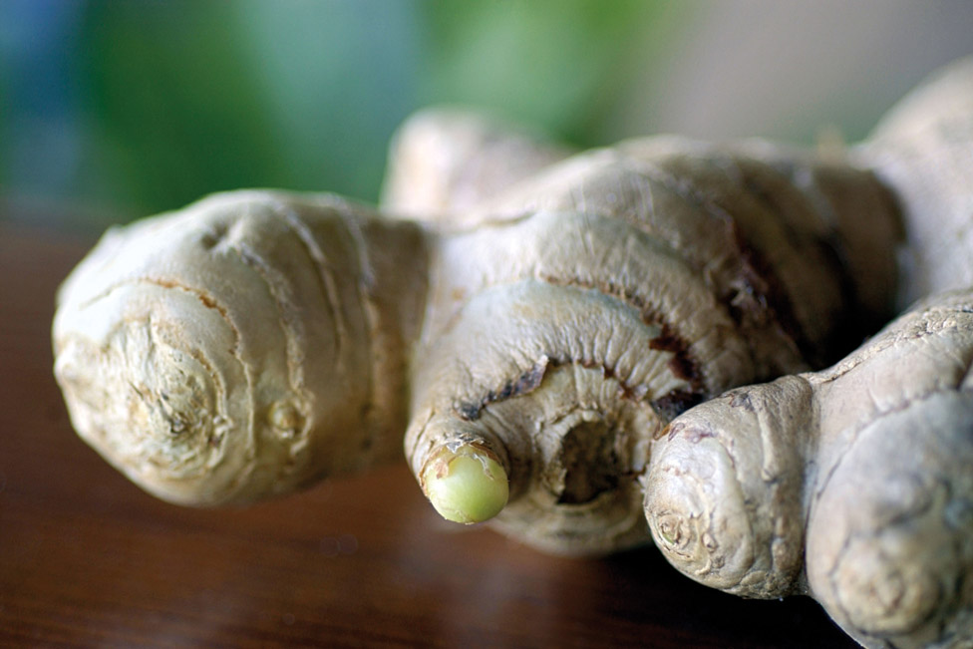
Stems support plants, transport materials, and provide storage.
Stems have many functions.
support leaves and flowers
house most of the vascular system
store water
Strawberry stolons
grow underground for storage
form new plants
Photosynthesis
Protection
Cactus
Ginger rhizomes
Potato tubers

Slide 8
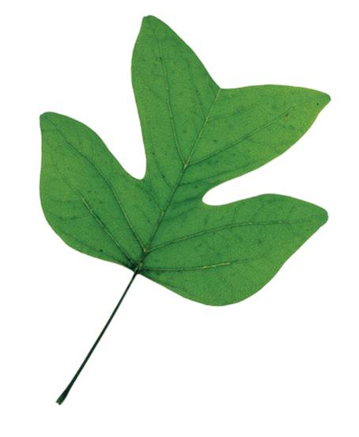
Most leaves share some similar structures.
The blade is usually broad and flat.
collects sunlight for photosynthesis
connects to the stem by a petiole
blade
petiole

Slide 9
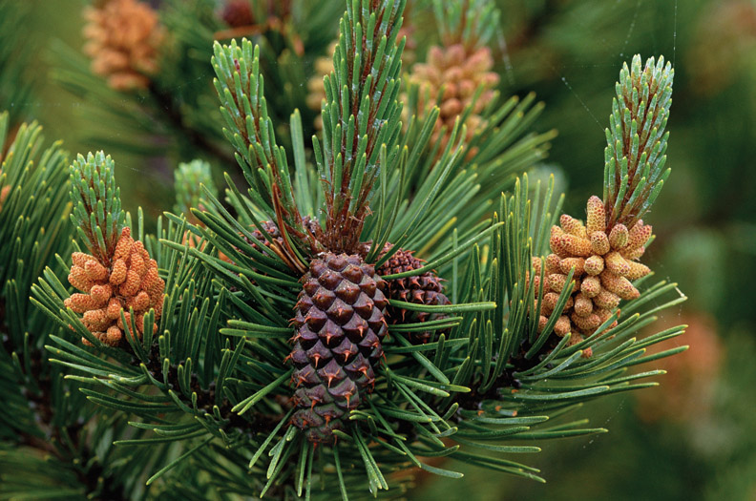
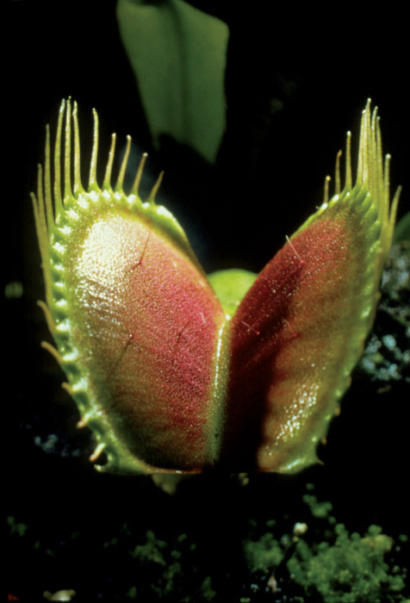
Leaves have many adaptations.
for extreme temperatures, ex: pine needles
for water loss, ex: cactus spines
For getting food, ex: Venus fly trap

Slide 10
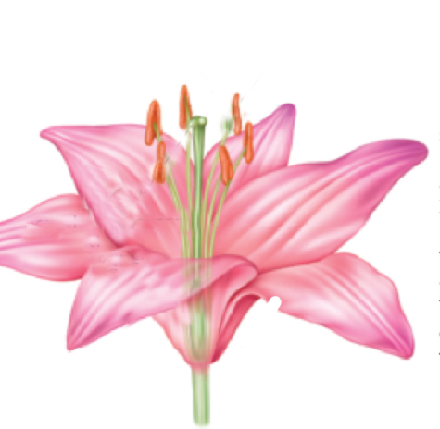
Flowers contain reproductive organs protected by specialized leaves.
Sepals and petals are modified leaves.
Sepals are outermost layer that protects developing flower
Petals can help to attract animal pollinators

Slide 11
A stamen is the male structure of the flower.
stamen
filament
anther
anther produces pollen grains
filament supports the anther

Slide 12
The innermost layer of a flower is the female carpel.
stigma
carpel
style
ovary
stigma is sticky tip
style is tube leading from stigma to ovary
ovary produces female gametophyte

Slide 13
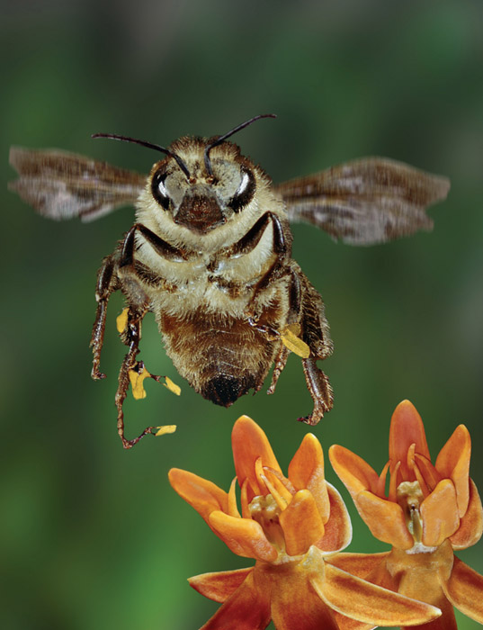
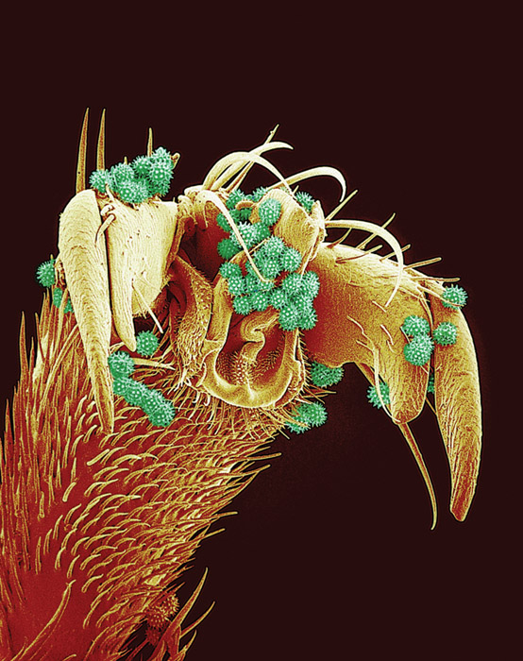
Flowering plants can be pollinated by wind or animals.
Flowering plants pollinated when pollen grains land on stigma.
Wind pollinated flowers have small flowers and large amounts of pollen.
Animal pollinated flowers have larger flowers and less pollen.

Slide 14
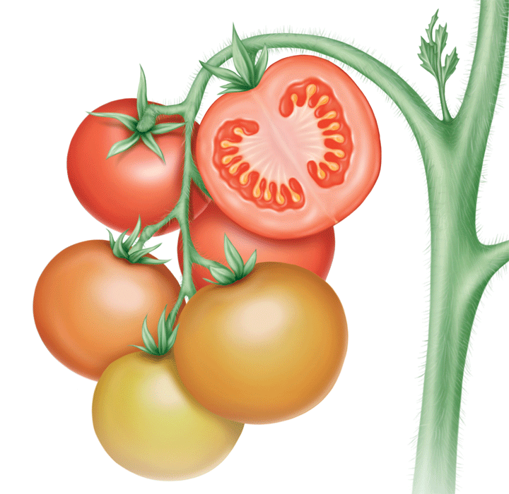
Once fertilization is complete, each ovule becomes a seed.
The surrounding ovary grows into a fruit.

Slide 15
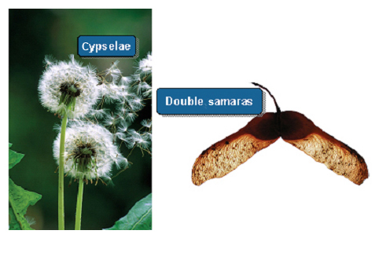
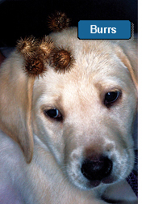
Animals, wind, and water can spread seeds.
Cypselae
Double samaras

Slide 16
Plant hormones regulate plant functions.
Hormones are chemical messengers.
produced in one part of an organism
stimulates or suppresses activity in another part

Slide 17
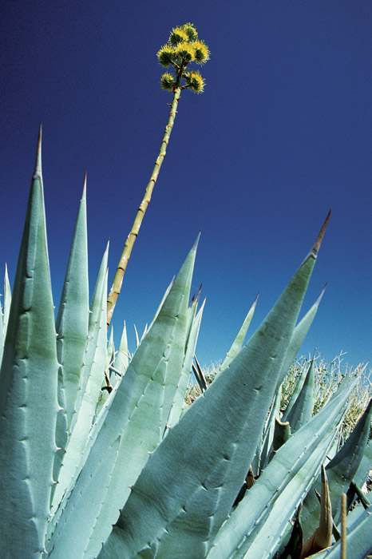
Gibberellins are plant hormones that produce dramatic increases in size.
ending seed dormancy
rapid growth of young seedlings
rapid growth of some flower stalks

Slide 18
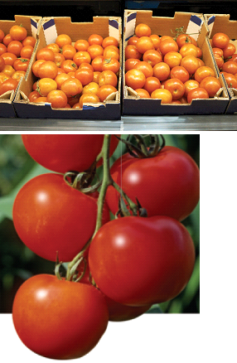
Ethylene causes the ripening of fruits.
some fruits picked before they are ripe
sprayed with ethylene to ripen when reach destination

Slide 19
Auxins lengthen plant cells in the growing tip.
stimulates growth of primary stem

Slide 20
Plants can respond to light, touch, gravity, and seasonal changes.
Tropism = growth or turning movement of a plant in response to an environmental stimulus.

Slide 21
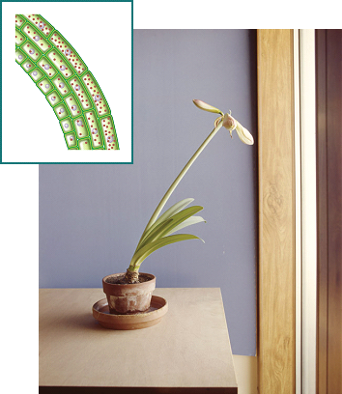
Phototropism is the tendency of a plant to grow toward light.
auxins build up on shaded side of stem
cells on shaded side lengthen
causes stem to bend toward light

Slide 22
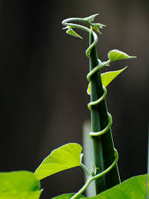
Thigmotropism is a plant’s response to touchlike stimuli.
climbing plants and vines
plants that grow in direction of constant wind

Slide 23
Gravitropism is a plant’s response to Earth’s gravitational pull.
positive gravitropism is downward growth (roots)
negative gravitropism is upward growth (shoots)

Slide 24
Some plants have rapid responses not involving growth.
Some responses protect plants from predators.
Some responses allow plants to capture food.

Slide 25
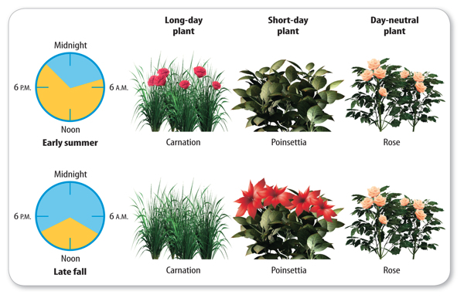
Photoperiodism is a response to the changing lengths of day and night.
triggers some plants to flower
triggers fall colors/winter dormancy of deciduous trees

