Slide 1

Section 1: Stability in Bonding
When atoms form compounds, each atom is more stable in the compound than it was by itself.
K What I Know | W What I Want to Find Out | L What I Learned

Slide 2

7(B) Recognize that chemical changes can occur when substances react to form different substances and that these interactions are largely determined by the valence electrons.
6(C) Analyze physical and chemical properties of elements and compounds such as color, density, viscosity, buoyancy, boiling point, freezing point, conductivity, and reactivity.
6(D) Relate the physical and chemical behavior of an element, including bonding and classification, to its placement on the Periodic Table.
2(D) Organize, analyze, evaluate, make inferences, and predict trends from data.
Stability in Bonding
Copyright © McGraw-Hill Education

Slide 3
Essential Questions
How does a compound differ from its component elements?
How do electron dot diagrams help predict chemical bonding?
Why does chemical bonding occur?
Stability in Bonding
Copyright © McGraw-Hill Education

Slide 4
Vocabulary
Review
compound
New
chemical formula
chemical bond
Stability in Bonding
Copyright © McGraw-Hill Education

Slide 5
Compounds
Some of the matter around you is in the form of uncombined elements such as copper, sulfur, and oxygen.
Copper, sulfur, and oxygen unite chemically to form a compound when the conditions are right. The green coating on the Statue of Liberty and some old pennies is a result of this chemical change.
The compound formed when elements combine often has properties that aren’t anything like those of the individual elements.
Stability in Bonding
Copyright © McGraw-Hill Education

Slide 6
Formulas
A chemical formula tells what elements a compound contains and the exact number of the atoms of each element in a unit of that compound.
The compound that you are probably most familiar with is H₂O, more commonly known as water.
This formula contains the symbols H for the element hydrogen and O for the element oxygen.
Notice the subscript number 2 written after the H for hydrogen.
Stability in Bonding
Copyright © McGraw-Hill Education

Slide 7
Formulas
A subscript written after a symbol tells how many atoms of that element are in a unit of the compound.
If a symbol has no subscript, the unit contains only one atom of that element. A unit of H₂O contains two hydrogen atoms and one oxygen atom.
Interactive Table
FPO Add link to Interactive Table animation from page 553 here.
Stability in Bonding
Copyright © McGraw-Hill Education

Slide 8
Chemical Bond Formation
The electric forces between oppositely charged electrons and protons hold atoms and molecules together, and thus are the forces that cause compounds to form.
Atoms of noble gases are unusually stable.
Stability in Bonding
Copyright © McGraw-Hill Education

Slide 9
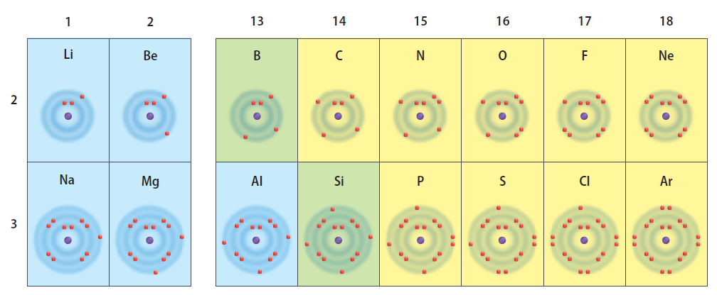
Electron dot diagrams
To understand the stability of atoms, it is helpful to look at electron dot diagrams.
Electron dot diagrams show only the electrons in the outer energy level of an atom.
Stability in Bonding
Copyright © McGraw-Hill Education

Slide 10
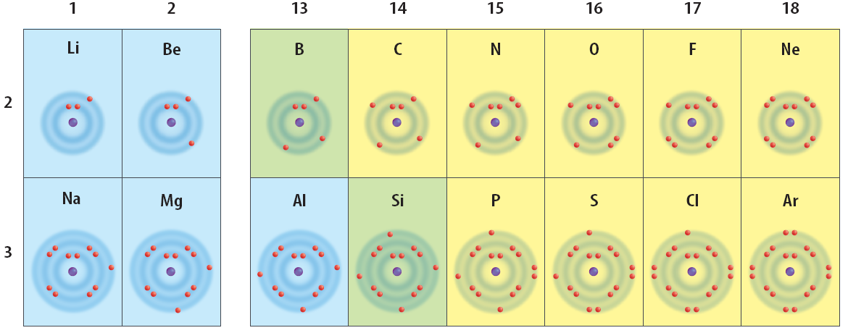
Electron dot diagrams
When you look at the elements in groups 13 through 17, you see that each of them falls short of having a stable energy level.
Each group contains too few electrons for a stable level of eight electrons.
Stability in Bonding
Copyright © McGraw-Hill Education

Slide 11
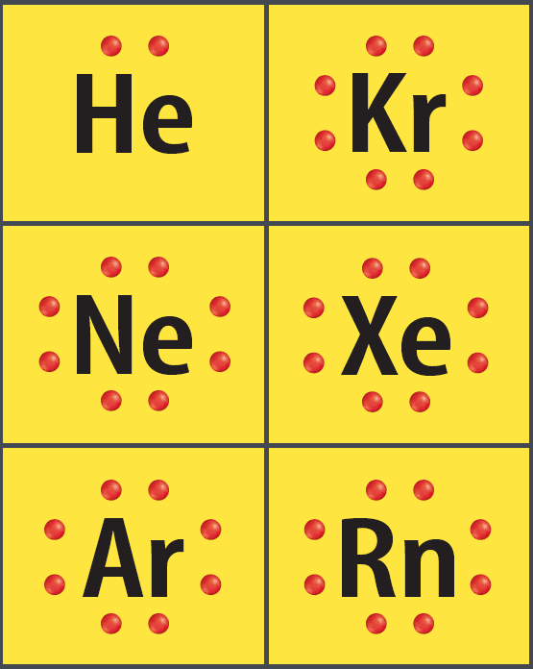
The unique noble gases
The noble gases are stable because they each have a complete outer energy level.
Notice that eight dots surround Kr, Ne, Xe, Ar, and Rn, and two dots surround He.
Stability in Bonding
Copyright © McGraw-Hill Education

Slide 12

Unfilled and filled energy levels
Hydrogen contains one electron in its lone energy level.
A dot diagram for hydrogen has a single dot next to its symbol. This means that hydrogen’s outer energy level is not full.
It is more stable when it is part of a compound.
Stability in Bonding
Copyright © McGraw-Hill Education

Slide 13
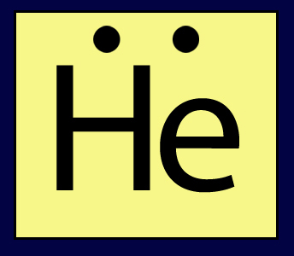
Unfilled and filled energy levels
In contrast, helium’s outer energy level contains two electrons.
Helium already has a full outer energy level by itself and is chemically stable.
Helium rarely forms compounds but, by itself, the element is a commonly used gas.
Stability in Bonding
Copyright © McGraw-Hill Education

Slide 14
Unfilled and filled energy levels
Animation
FPO Add link to concepts in motion animation from page 555 here.
Stability in Bonding
Copyright © McGraw-Hill Education

Slide 15
Outer levels—getting their fill
How does hydrogen, or any other element, trying to become stable, gain or lose its outer electrons?
They do this by combining with other atoms that also have partially complete outer energy levels.
As a result, each achieves stability.
Stability in Bonding
Copyright © McGraw-Hill Education

Slide 16
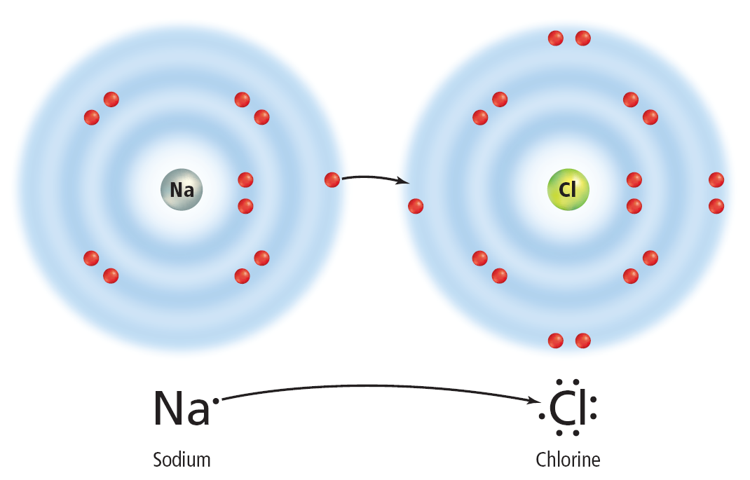
Gaining a losing electrons
When sodium and chlorine combine, sodium loses one electron and chlorine gains one electron.
You can see from the electron dot diagram that chlorine now has a stable outer energy level.
Sodium had only one electron in its outer energy level, which it lost to combine with chlorine.
This is now the new outer energy level, and it is stable with eight electrons.
Stability in Bonding
Copyright © McGraw-Hill Education

Slide 17
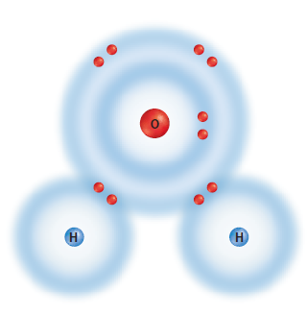
Chemical bond formation
A chemical bond is the force that holds atoms together in a compound.
When atoms gain, lose, or share electrons, an attraction forms between the atoms, pulling them together to form a compound.
This attraction is called a chemical bond.
Stability in Bonding
Copyright © McGraw-Hill Education

Slide 18
Review
Essential Questions
How does a compound differ from its component elements?
How do electron dot diagrams help predict chemical bonding?
Why does chemical bonding occur?
Vocabulary
chemical formula
chemical bond
Stability in Bonding
Copyright © McGraw-Hill Education

