Slide 1

Section 2: Types of Bonds
Atoms form ionic bonds by transferring electrons and form covalent bonds by sharing electrons.
K What I Know | W What I Want to Find Out | L What I Learned

Slide 2

7(B) Recognize that chemical changes can occur when substances react to form different substances and that these interactions are largely determined by the valence electrons.
2(E) Communicate valid conclusions.
Types of Bonds
Copyright © McGraw-Hill Education

Slide 3
Essential Questions
What are ionic bonds and covalent bonds?
Which particles are produced by different types of bonding?
How do nonpolar and polar covalent bonds compare?
Types of Bonds
Copyright © McGraw-Hill Education

Slide 4
Vocabulary
Review
atom
New
ion
ionic bond
covalent bond
molecule
nonpolar bond
polar bond
polar molecule
nonpolar molecule
Types of Bonds
Copyright © McGraw-Hill Education

Slide 5
Ions
An atom that has lost or gained electrons is called an ion. An ion is a charged particle because it now has either more or fewer electrons than protons.
Atoms lose or gain electrons to meet a standard—a stable energy level.
The positive and negative charges are not balanced.
It is the electric forces between oppositely charged particles, such as ions, that hold compounds together.
Some of the most common compounds are made by the loss and gain of just one electron.
Types of Bonds
Copyright © McGraw-Hill Education

Slide 6
Ions
Animation
FPO Add link to concepts in motion animation from page 558 here.
Types of Bonds
Copyright © McGraw-Hill Education

Slide 7
Transfer of electrons
A neutral atom of potassium has one electron in its outer level. This is not a stable outer energy level.
When potassium forms a compound with iodine, potassium loses one electron from its fourth level, and the third level becomes a complete outer level.
The potassium atom has become an ion.
When a potassium atom loses an electron, the atom becomes positively charged because there is one electron less in the atom than there are protons in the nucleus
The 1+ charge is shown as a superscript written after the element’s symbol, K⁺ , to indicate its charge.
Types of Bonds
Copyright © McGraw-Hill Education

Slide 8
Transfer of electrons
The iodine atom in this reaction undergoes a change.
An iodine atom has seven electrons in its outer energy level.
During the reaction with potassium, the iodide atom gains an electron, leaving its outer energy level with eight electrons.
This atom is no longer neutral because it gained an extra negative particle.
It now has a charge of 1− and is called an iodide ion, written as I⁻.
Types of Bonds
Copyright © McGraw-Hill Education

Slide 9
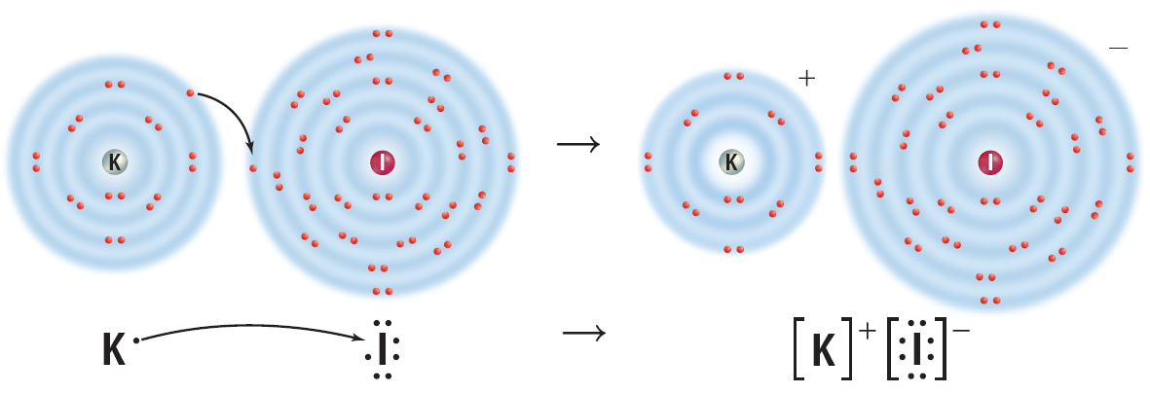
Transfer of electrons
Notice that the resulting compound has a neutral charge because the positive and negative charges of the ions cancel each other.
Types of Bonds
Copyright © McGraw-Hill Education

Slide 10
The ionic bond
An ionic bond is the force of attraction between the opposite charges of the ions in an ionic compound.
In an ionic bond, a transfer of electrons takes place.
If an element loses electrons, one or more elements must gain an equal number of electrons to maintain the neutral charge of the compound.
Types of Bonds
Copyright © McGraw-Hill Education

Slide 11
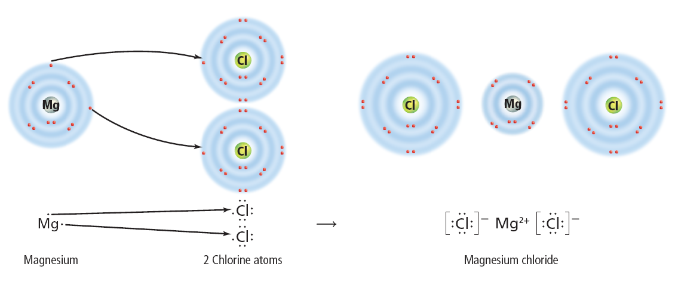
The ionic bond
The formation of magnesium chloride, MgCl₂, is another example of ionic bonding.
When magnesium reacts with chlorine, a magnesium atom loses two electrons and becomes a positively charged ion, Mg²⁺.
At the same time, two chlorine atoms gain one electron each and become negatively charged chloride ions, Cl⁻.
Types of Bonds
Copyright © McGraw-Hill Education

Slide 12
The ionic bond
Animation
FPO Add link to concepts in motion animation from page 560 here.
Types of Bonds
Copyright © McGraw-Hill Education

Slide 13
Zero net charge
The result of this bond is a neutral compound.
The compound as a whole is neutral because the sum of the charges on the ions is zero.
When atoms form an ionic compound, their electrons are shifted to the other atoms, but the overall number of protons and electrons of the combined atoms remains equal and unchanged. Therefore, the compound is neutral.
Ionic bonds usually are formed by bonding between metals and nonmetals.
Types of Bonds
Copyright © McGraw-Hill Education

Slide 14
Molecules
Some atoms of nonmetals are unlikely to lose or gain electrons.
For example, the elements in Group 4 of the periodic table have four electrons in their outer levels.
They would have to either gain or lose four electrons in order to have a stable outer level.
The loss of this many electrons takes a great deal of energy.
Therefore, these atoms become more chemically stable by sharing electrons, rather than by losing or gaining electrons.
Types of Bonds
Copyright © McGraw-Hill Education

Slide 15
The covalent bond
The attraction that forms between atoms when they share electrons is known as a covalent bond.
A neutral particle that forms as a result of electron sharing is called a molecule.
Types of Bonds
Copyright © McGraw-Hill Education

Slide 16
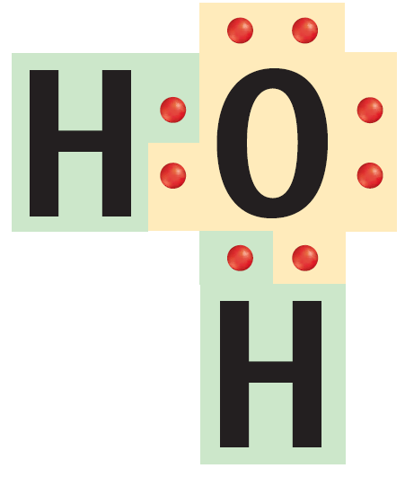
The covalent bond
A single covalent bond is made up of two shared electrons.
A water molecule contains two single bonds. In each bond, a hydrogen atom contributes one electron to the bond and the oxygen atom contributes the other.
The result of this type of bonding is a stable outer energy level for each atom in the molecule.
Types of Bonds
Copyright © McGraw-Hill Education

Slide 17
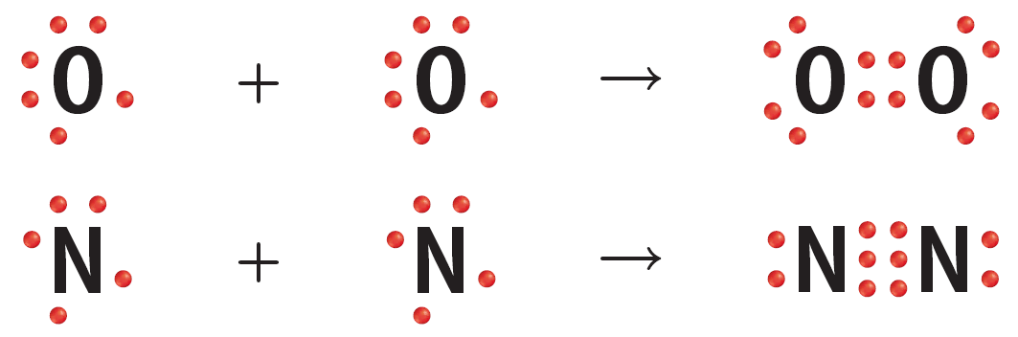
Multiple covalent bonds
A covalent bond also can contain more than one pair of electrons.
An example of this is the bond in oxygen (O₂) or nitrogen (N₂).
Types of Bonds
Copyright © McGraw-Hill Education

Slide 18
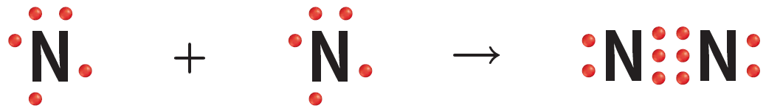
Multiple covalent bonds
A nitrogen atom has five electrons in its outer energy level and needs to gain three electrons to become stable.
It does this by sharing its three electrons with another nitrogen atom.
When each atom contributes three electrons to the bond, the bond contains six electrons, or three pairs of electrons.
Each pair of electrons represents a bond.
Therefore, three pairs of electrons represent three bonds, or a triple bond.
Types of Bonds
Copyright © McGraw-Hill Education

Slide 19
Equal sharing
A nonpolar bond is a covalent bond in which electrons are shared equally by both atoms.
Types of Bonds
Copyright © McGraw-Hill Education

Slide 20
Unequal Sharing
Electrons are not always shared equally between atoms in a covalent bond.
These elements are close together in the upper right-hand corner of the periodic table.
The strength of the attraction of each atom to its electrons is related to
  the size of the atom
  the charge of the nucleus
  the total number of electrons the atom contains
Types of Bonds
Copyright © McGraw-Hill Education

Slide 21
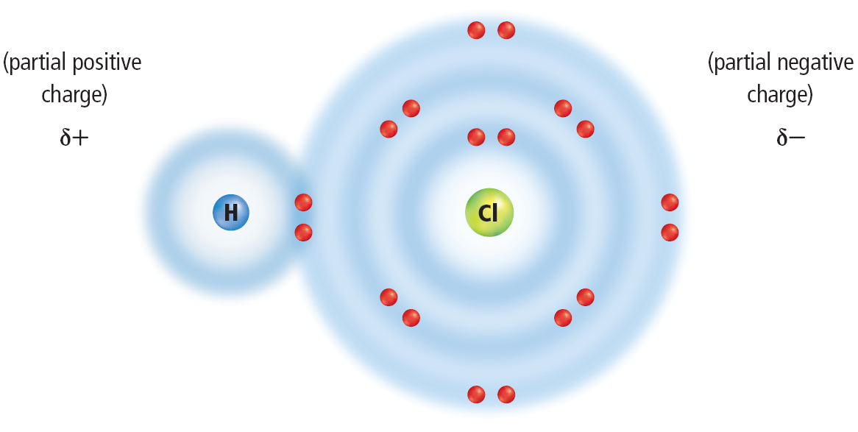
Partial charges
One example of this unequal sharing is found in a molecule of hydrogen chloride, HCl.
Chlorine atoms have a stronger attraction for electrons than hydrogen atoms do.
Types of Bonds
Copyright © McGraw-Hill Education

Slide 22
Partial charges
As a result, the electrons shared in hydrogen chloride will spend more time near the chlorine atom than near the hydrogen atom.
Types of Bonds
Copyright © McGraw-Hill Education

Slide 23
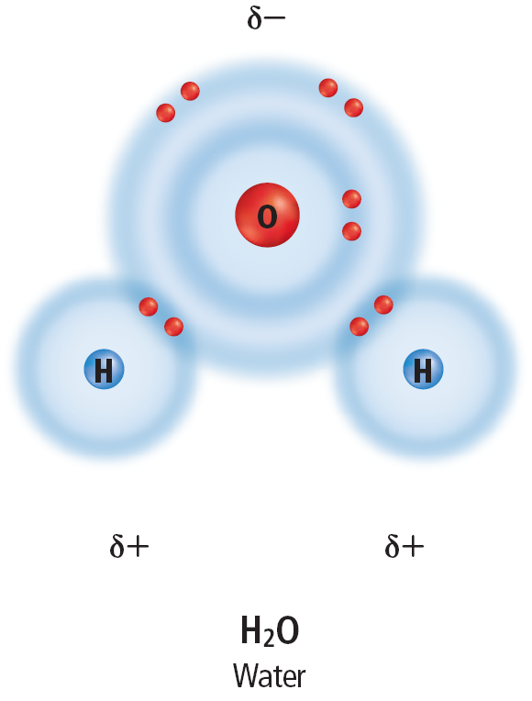
Polar and nonpolar molecules
The charge is balanced but not equally distributed. This type of molecule is called polar bond.
A polar molecule is one that has a slightly positive end and a slightly negative end although the overall molecule is neutral. Water is an example of a polar molecule.
A nonpolar molecule is one in which electrons are shared equally in bonds. Such a molecule does not have oppositely charged ends.
Types of Bonds
Copyright © McGraw-Hill Education

Slide 24
Review
Essential Questions
What are ionic bonds and covalent bonds?
Which particles are produced by different types of bonding?
How do nonpolar and polar covalent bonds compare?
Vocabulary
ion
ionic bond
covalent bond
molecule
nonpolar bond
polar bond
polar molecule
nonpolar molecule
Types of Bonds
Copyright © McGraw-Hill Education

